Slide 1

Chapter Nominations Training
Presented by Holly Dotson, CMP
Director Chapter Operations
September 21, 2016
Notes:
WELCOME
Introduction
MY MPI Background
Welcome Nominating Committees and Board Members

Slide 2
Presentation Objectives
Succession Planning – Understanding What It Is
Your Role in Succession
Necessary Leadership Qualities
Great Boards, What Do They Look Like?
What Skills Will Our Board Need?
Committee & Processes
Slate Submissions
Questions

Slide 3

Notes:
Today our focus is not so much on Succession planning as a whole but more the actual process of selecting the board. This process is part of the overall succession planning picture so a quick high level view for those of you who maybe haven’t served in the past might be helpful.
No chapter can run without it’s leaders…you need to have a plan for how your business will continue to run after you or the leaders leave.
- Succession planning is a process for identifying and developing members with the end goal to potential fill key leadership position in your organization.
- It increases the availability of experienced and capable people that are prepared to assume roles and responsibilities as they become available.
- Effective succession planning helps to build a series of feeder groups up and down your entire leadership pipeline or progression that you can pull from as needed to avoid challenges or holes within your leadership structure. This is important as you need strong and prepared leaders to sustain your business model

Slide 4
Higher
expectations
Hosting
organizations
Increased
sophistication
in the
meeting
industry
Different
skills in the
industry
should be
reflected in
leadership
Expectations
of leaders
are greater
than ever
Industry
challenges
change the
standard of
leadership
Notes:
Why is this important to you, the nominating committee and your chapters. Review bullets on chart
Your role - You have been selected to be part of the process for succession planning
- Your role is one of the most important for the board as you will help determine who the leaders of tomorrow will be. With great priveldge comes great responsibility though
- Understanding that you have a commitment to the board to select the right leaders to carry the chapter forward.
- To ensure that you are following procedures, guidelines and fully committed to the success of your task
The decisions you make on this committee truly leave a legacy and have great impact on not only the coming term but future terms.

Slide 5
Evolution from
representative
based board
Used as a self-assessment tool
Skills & experience matrix to evaluate prospective candidates
Notes:
You are there to ensure – see bullets
Chapters need to evolve from using the typical representative based board
- Warm body, they were willing and we had no other
- We need 50% suppliers and 50% planners
- Or perhaps the thought process of Susie has been on the board for 5 years it’s her turn mentality
Evolving more to a skills and experience based approached allowing us to thoughtfully determine the needs of the chapter, the mission at hand and who is best suited to carry out the responsibility
Leadership is not entitlement! Remember, the right leaders at the table is what makes

Slide 6
Leadership
Fiduciary
Responsibility
Strategic
Thinking
Individual
Skills
Business
Acumen
Personal
Communication
Loyalty to
MPI
Influence
Notes:
You start this process by evaluating what Individual leadership skills are needed in order to serve on the chapter board. What do you need them to bring to the table for your board to be successful.
These listed are a good starting point, these are what is considered by the International Board for their board candidates. Candidates that do not posses these skills or a portion of them should in most cases not be considered for board service. These would be considered the basic skills to serve on your board.
Leadership
Ability to lead; viewed by others as leader; excellent reputation in the community; self-awareness - the ability to read one's emotions and recognize their impact while using gut feelings to guide decisions; self-management - involves controlling one's emotions and impulses and adapting to changing circumstances.
Strategic Thinking
Strategic approach to finding and developing unique opportunities to drive value
Understanding of fundamental drivers of business and vigorously challenging conventional thinking about them
Personal Communication Skills
Demonstrated strong verbal and written communication skills; the ability to sense, understand, and react to other's emotions while comprehending social networks. Experience in organization and group dynamics.
Influence
Demonstrated ability to inspire, influence and develop others while managing conflict
Loyalty to MPI
Act in the best interests of MPI and its members rather than the personal interest of the individual or other individual(s)
Business Acumen
Demonstrated knowledge of sound business practices; ability to make an insightful assessment of the external business landscape with the keen awareness of how success can be achieved — and then monitoring execution of the strategy to deliver the desired results.
Fiduciary Responsibility
Duties of due care, loyalty, and acting in good faith

Slide 7
SAMPLE Skills and Experience Matrix
 | Individual Skills |  |  |  |  |  |  | Collective Skills
Applicant | Leadership | Strategic Thinking | Personal Comm. Skills | Influence | Loyalty to MPI | Business Acumen | Fiduciary Respons. | Chapter / Community Experience | Diversity-Reflective of Membership | Association Experience | Financial Expertise | Governance | Strategic Planning | Industry Experience | Marketing
Notes:
At MPI, the Governance and Nominating committee uses a skills matrix document to help create a balanced Board of Directors that fit the required skills needed in order to accomplish the goals set forward. Not everyone has the same skills as a leader. This assessment is useful and successful because…
It helps define candidates who are definitely ready and those who are definitely not.
It provides a clearer picture of unusual strengths and developmental gaps a potential candidate might have
It offers a method for developing an overall picture of who and what is required to fit the appropriate talent and people required in the roles of your chapter.
This document is available in the CLRP under succession planning, skills matrix

Slide 8

Leaders – What do they look like?
Notes:
So let’s talk a little more about leadership, how do you recognize a good leader vs. a great leader
Selecting the appropriate leaders is the key to a great board.
Remember we discussed earlier moving from a representative based board to a board full of leaders with the key skills and talents we need to fulfill our vision, mission and values.

Slide 9
What Do Great Leaders Say & Do?
Characteristics | Weak Leaders | Ok Leaders | Good Leaders | Great Leaders
What they say | It’ll look great on my resume! | What do I have to do? | How may I help? | Thanks for the opportunity.
What they add | Dead weight | Basics | Dedication | Passion
What they take | Valuable spot | Instructions | Role seriously | Time to care
How they look | Cool | Regular | Eager | Unassuming
What they read | TV guide | Time magazine | Books | Business Magazines & Books
Whom they serve | Themselves | Their obligations | The nonprofit | The community
Notes:
Taking time in the interview process and hopefully through your application process you can determine the types of leader

Slide 10

Great Boards Are they out there?
Notes:
So now that you understand you need a strong leaders to support your chapter. We need to look at your board, what makes a great board, what gives them the ability to stand out and move the bar for your membership, achieve their vision and mission and grow the organization.
So often our vision of what a great board is may come from our only experience, perhaps you have served in the past or you are serving now. Your board may be doing great things and you are having a wonderful experience. But sometimes, the wrong people are placed on a team and it can create great challenges and an unfavorable experience for our volunteer leaders.

Slide 11
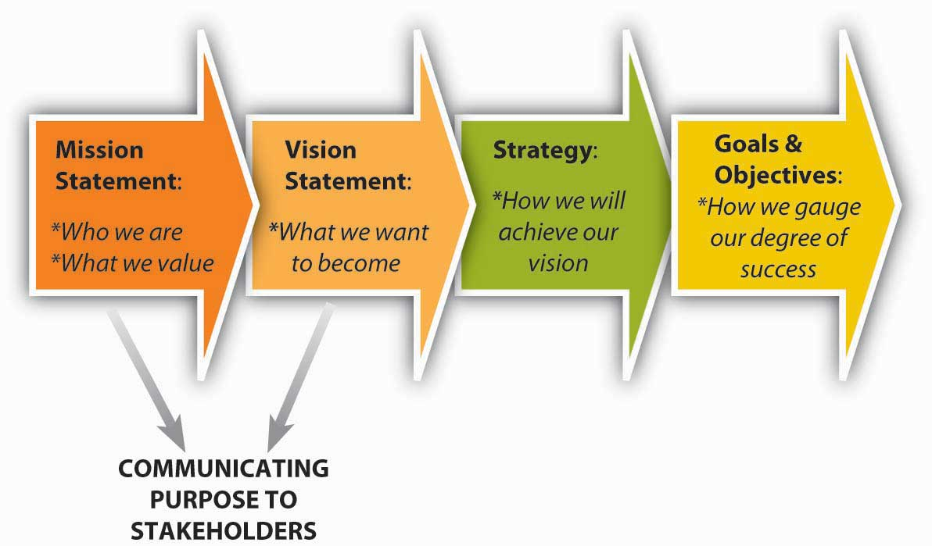
What do “GREAT” Boards Possess?
They understand “What Matters Most” for the organization
Notes:
So what do great boards possess?
They understand what matters most –
- Mission, why do you exist
- Vision, where are you going
- values, what guides you
- They are in alignment with the goals set forth by the board as a whole and are driving them
They are proud of who they are and what they provide
They have clear policies and procedures and use them
They set clear board expectations and are accountable to them
They understand it is an honor to serve
They understand it is a serious commitment
For those of you currently serving, think about your board today. Can you say this about your team? Think about how it is affecting your experience, time commitment and passion. I hope your answer is yes, that is the goal of the nominating committee.

Slide 12

What do “GREAT” Boards Possess?
-
Notes:
Other traits of Great boards
They are Servant Leaders
They are Trust-holders of the Membership
They are Working for the Common Good
They are willing to Assess themselves and their practices
They are meeting fiduciary obligations
Time – They attend board meetings and are prepared
Treasure – They donate and support the events of organization
Talent – They bring their talents to the game and use them
Integrity – They practice it daily

Slide 13

What skills does your board need to be great?
Notes:
- Now that you understand that your role is to find great leaders for your board.
- You have a clearer picture of what a great board would look like, the types of characteristics that they portray
- You have a good start! You now have the basics and understanding of what you are trying to accomplish – A great board full of strong, committed leaders with a passion for MPI!
- So what are your next steps – It’s important to understand what skills does the board need filled in order for the right leaders to carry out their mission?
- Make sure your board has given you clear directions on what their expectations are for their coming board
- What challenges are they having
- What vision lies before them that this new board will be tasked with carrying out.
Now your board may say we don’t know our goals for next year, and that is true, it will officially be determined after the board is selected but they should be able to give you a general sense of what they are trying to accomplish.

Slide 14
Collective
Skills of the
Board
Association Experience
Financial
Expertise
Community
Experience
Governance
Knowledge
Strategic
Planning
Industry
Experience
Marketing
Expertise
Diversity –
Reflective of
Membership
Functional
Experience
Notes:
What collective skills will they need at the table to carry out their vision?
Remember - You have already determined that they have the required individual leadership skills for board service to ensure you have the right type of leaders. But you should determine what collective skills do we need on our board in order to meet the needs of our membership and business plans that we have.
This list here is a good general basis for MPI boards, based on typical needs, goals and the overall organizations goals candidates that do not posses these skills or a portion of them should in most cases not be considered for board service.
You may need to evaluate these though and make adjustments based on your demographic.
Association Experience
Basics of association management and guidelines.
Community Experience/Leader
Volunteer activity at either the chapter or other community levels
Diversity
Reflective of the membership/industry
Functional Experience
Reflective of vertical Industry segments
Global Mindset/Emerging Markets Expertise
Mindset and approach which is open to universal concepts and implications of decisions worldwide
Financial Expertise
Demonstrated skill in financial principles and analysis
Global Operational Experience—Non-Profit or Corporate
Work experience with a global enterprise
Governance
Knowledge of the principles of good governance; successful experience on corporate and/or nonprofit boards so that best practices can be shared
Strategic Planning
Competency and experience
Industry Experience
Experience in one or more aspects of the global meetings industry
Marketing
Evidence of knowledge and application of marketing principles

Slide 15

Notes:
– If the world were a perfect place and you could create the ultimate board what would it look like?
Genuine interest & passion for membership
Positive person -a can-do-attitude
Willingness to commit the time
Good Listener
Visionary
Leadership qualities
Team Player
Your board should as part of their nominations process give you guidance on these things. Ask for a meeting with your Office of the President or have your chair, the Immediate Past President assist you with determining these items.

Slide 16



Would Be Nice To Have…
Notes:
– These things are valuable but secondary to good leadership and Must have’s
Specific skills and talents – For example marketing experience. Not all individuals need to possess this to serve. Potentially none, you could gain this skill in a committee member. Strong leaders will surround themselves with committee members who posses the skills they lack.
Areas of expertise
Contacts – Great to have, but not necessary to serve
Influence in the Community/Industry

Slide 17
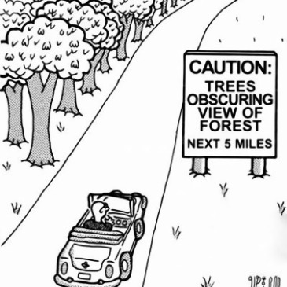
Not in a Million Years Criteria
Notes:
– These things are valuable but secondary to good leadership and Must have’s
Specific skills and talents – For example marketing experience. Not all individuals need to possess this to serve. Potentially none, you could gain this skill in a committee member. Strong leaders will surround themselves with committee members who posses the skills they lack.
Areas of expertise
No what you won’t accept either. It’s better to have an empty spot than filling it with the wrong individual because you have no one else.
Talks too much – they keep progress from happening
Arrogant
Not the right motivation
Is already serving on too many boards
Not a team player
Doesn’t see the forest for the trees – The get caught in the weeds. They are in too deep and can’t process the big picture
Works in a company at odds with our mission
Influence in the Community/Industry

Slide 18

Notes:
Ok, so let’s recap
- You now know that you have an important role
- you need to select strong leaders to serve on the great board you are trying to build
- You understand the collective skills you need, your must have criteria, the boards wants vs. needs and you have even know what you won’t allow or accept.
It’s time to start the process of selecting these individuals, and putting pen to paper.

Slide 19
What is your process?
What Leadership Skills and Collective Skills We Need?
Clarify Must Have vs.
Can’t Have
Application process and procedures - Timelines
Candidate Selection
Skills Matrix, Interviews, Voting
Final Selections and Notifications
Submit for Board Approval & Membership Approval
Final Announcement to Membership
On-Boarding
Installation
Notes:
Finally – Your Process. You need to have clear procedures in place for each step of the process. Some are defined by MPI Global and others are developed at the chapter level. Know where yours are and share with the full committee the procedures.
Do you have a plan for the events that must happen
If you’re not prepared you can easily pick the wrong people.
What is your process for applications, interviews, selection and on. We have tools available if you don’t have a plan. CLRP can support you and your CBM. We are not going into detail here today about the flow of applications to selection as each chapter should have a policy or process in place already and they vary. The goal for you today is to make sure you understand what that is. If your chapter doesn’t have this then set up a call with your CBM immediately and they can support as well as CLRP.
ALWAYS recruit from a position of strength
It’s an honor to be asked to serve on a board
It is a serious commitment to serve on a board
NEVER revert to accepting just warm blood and pulse
You DO NOT need high profile people
Your organization is Worthy!
Be clear about what matters most – vision/mission
Set clear, written board expectations and share in advance of placement
Know what you need
Know who you are looking for
Everyone is recruiting from the same expectations of what you want and need to accomplish
Have clear job descriptions
Recruit based on who you are AND who fits best with who you are and where you want to go

Slide 20
Nominations Processes
- Explain the process to your prospects
- Make no commitments
- Compare your prospect to your Criteria
- Don’t lower your expectations
- Plan your interview questions in advance
- Never ask how much time they have to give
- State how much time it will take, remember serving is an honor
Notes:
Be sure your processes include
Create Interview Questions from your Must Have Criteria
Where do they lead currently, are they putting themselves out there, learning and growing
Do they have a positive attitude or are they telling you they don’t have time
Never ask how much time are they willing to give
State how much time it will take, remember you are proud of who the organization is and you believe in the work. If they feel honored they will be willing
Potential Questions
Are you involved with any other boards
Have you ever served on a board before
Tell us about your volunteer experiences
What causes are you passionate about
What interested you in this opportunity
What special skills would you bring to this board
How would you add value to our organization
Discuss time commitment

Slide 21
Nominating Committee Guidelines
Committee Guidelines per Bylaws
- Immediate Past President is Chair
- President Elect serves on committee with voting rights
- Minimum of 4 committee members including chair is required
- Committee members may not be applying for the board
- Understand and know guidelines on term limits & Re-election

Slide 22
Nominating Committee Policies
Term Limits
- All Officers and Directors are one year terms
- Everyone has to re-apply (Incoming President and Incoming IPP excluded)
- Understand consecutive term policies
- Leadership is not entitlement
-
Notes:
Officer Term limits
Serve one year term in any role. Can re-apply for an additional one year term in the same role for a total of two consecutive years. After two terms they must apply for an alternate role
After skipping a year they can apply for that same role again.
In the event they were filling a role that had yet expired, for example stepped in for the last 3 months of a year. That term shall not be considered for re-election purposes and it doesn’t count toward the two terms.
Directors
One year term and can apply for up to two additional one year terms in the same role. After serving 3 consecutive years they would need to apply for an alternate role.
Directors can only serve a maximum of 6 consecutive years in a directors role. At that point they either need to be elected as an officer or step down.
If this doesn’t match what your chapter does you need to contact your CBM and they can assist you in clarifying your policies.
Your chapter administrators can also assist with terms, who has served where and for how long. This will give you a clear picture of who is eligible for what roles, who cannot reapply, etc.

Slide 23
Slate Submission/Approval Policies
- Present your recommended slate to the board
- Board votes on Officers
- This must happen by mid-January
- Membership votes on Directors
- This should happen by late January
- Allow 30 Days for membership to vote
- Submit to MPI no later than March 1, 2017 approved
- OnBoarding, Transitions, Contact info (training provided)
- Board Installation
Notes:
Step one – Present the slate to the board on the external slate template provided in CLRP – The board will approve the officers
Step two - Present your slate to membership on the template provided with the wording already created for you. Allow 30 days for vote
Step three – Chapter administrator or IPP, need to verify will submit the slate to your CBM on the internal slate template with member ID (This should be verified prior to membership voting)
Step Four – Will begin with plan for on-boarding chapters, sending in full roster with contact info to CBM and official transition plans
Step Five – Install your board at the annual meeting

Slide 24
Resources
- Instructions on CLRP
- Templates Provided
- Membership process templates
- Succession timelines
- Interview question samples
- Application samples
- Skills Matrix
Notes:
We have everything you need on the CLRP. Work with your chair (IPP) to ensure you have everything. The board should have this in place for the committee but if not work with them to determine your plan.

Slide 25
Chapter Leader Resource Page
How to Access the CLRP
- Visit www.mpiweb.org
- Log in, you account
- Select Chapter Leader Resources
- Office of President Tab – Succession Plannin

Slide 26


Slide 27
Thank You!
Holly Dotson, CMP
Director Chapter Operations
hdotson@mpiweb.org
407-592-0644

