Slide 1

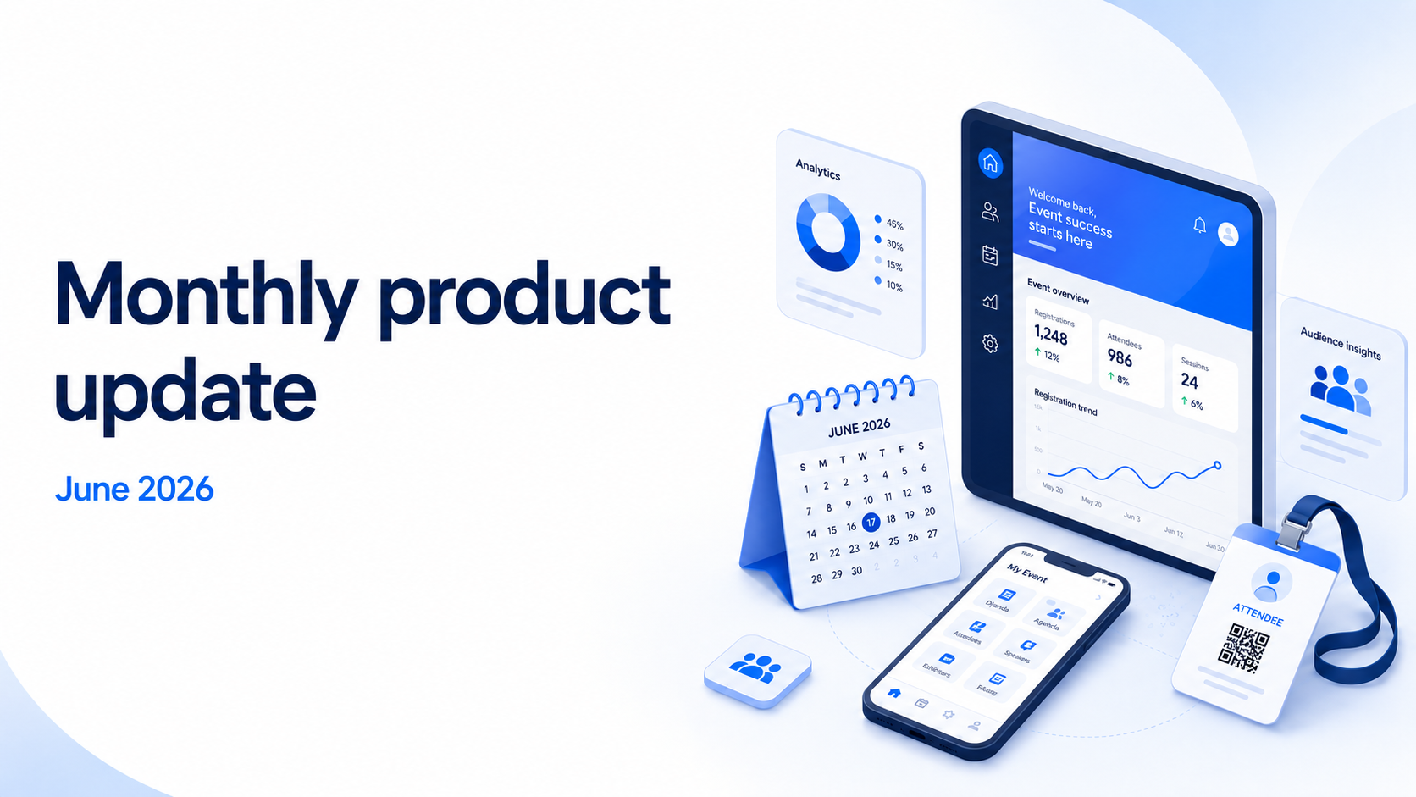


Slide 2

About the newsletter
The June updates are grouped into six product neighborhoods to make it easier to review what changed, why it matters, and where each update fits across the Cvent platform.
Plan & Promote
Exchange Solutions
Registration, Abstract Management, Speaker Resource Center, Exhibitor Management
Cvent Supplier Network, Event Diagramming, Passkey, Cvent Travel, Instant Book, Vendor Marketplace powered by Reposite
Attendee Engagement
Spend & Workflow
Attendee Hub, Events+, Appointments, OnArrival, LeadCapture, Webinar, Essentials
Budget Management, Meeting Request Form, Access Portal
Actionable Insights
Trade Show Solutions
Surveys, Reporting, Integrations, Engagement Scoring, App Marketplace
iCapture, Jifflenow

Slide 3

3
Additional resources
Helpful links for product news, roadmap visibility, and subscription management.
Announcements
Browse all Event Marketing & Management product news.
Roadmap
See what is currently planned on the release roadmap.
Open Forum
Ask questions about rolled-out updates in the Cvent Community.
Subscribe to Product News
Get an email whenever a new product news update is published.
Manage Subscription
From the Product News home page, choose “Manage Subscription” to tailor which product interest areas you receive.
Cvent Monthly Product News — June 2026

Slide 4

4
Plan & Promote
Registration, Abstract Management, Speaker Resource Center, Exhibitor Management
Cvent Monthly Product News — June 2026

Slide 5


5
REGISTRATION
Self-Serve Setup for Custom & Envelope Domains (SPF Only)
What changed: Account administrators can add, verify, edit, and manage planner and envelope domains directly in the product without opening a support ticket.
Branded email,
without the ticket
Why it matters: Teams can move faster on branded email communications while improving trust, deliverability, and alignment with enterprise IT policies.
Use case: Use it when a time-sensitive event needs a verified sender domain quickly; this phase supports SPF-based setup today.
Link
Cvent Monthly Product News — June 2026

Slide 6
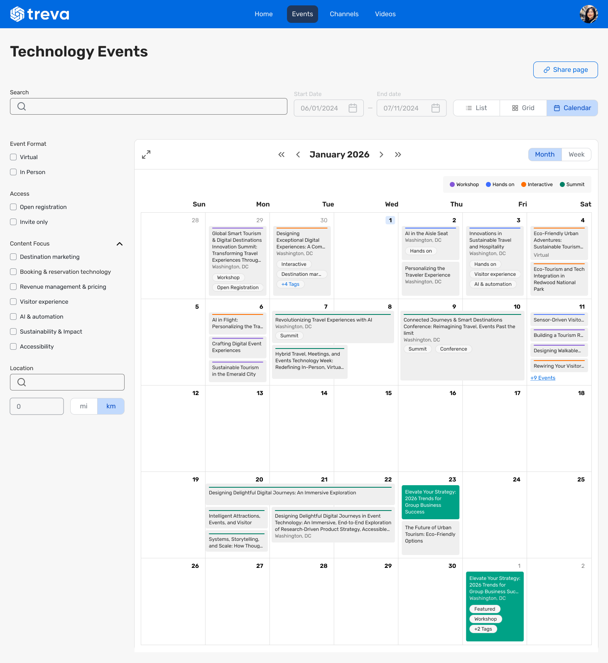
6
REGISTRATION / ATTENDEE HUB / EVENTS+ / ACCESS PORTAL
Event Calendar: Calendar View
What changed: Event Calendars now support Calendar View alongside List and Grid, with month/week views and easy date navigation.
Why it matters: Attendees can understand what is happening and when through a familiar calendar-style experience across supported calendar surfaces.
Use case: Set Calendar View as the default when your audience needs to scan programming by date instead of by list.
Link
Cvent Monthly Product News — June 2026

Slide 7
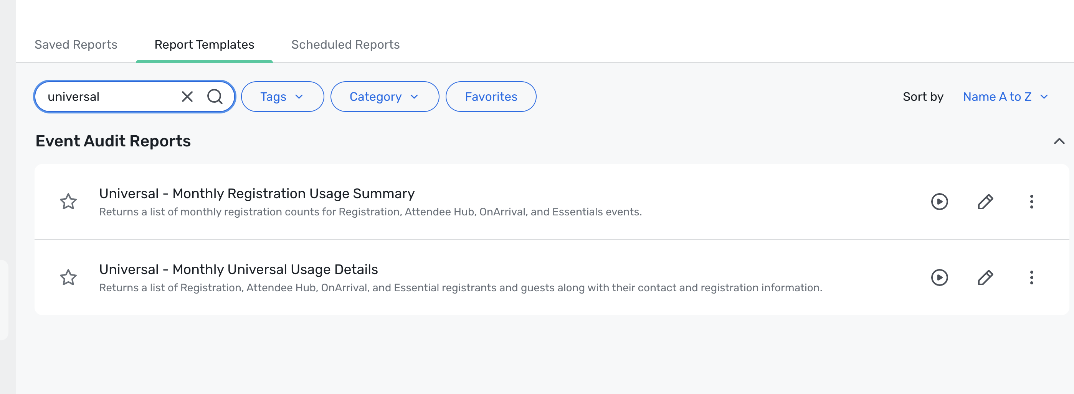
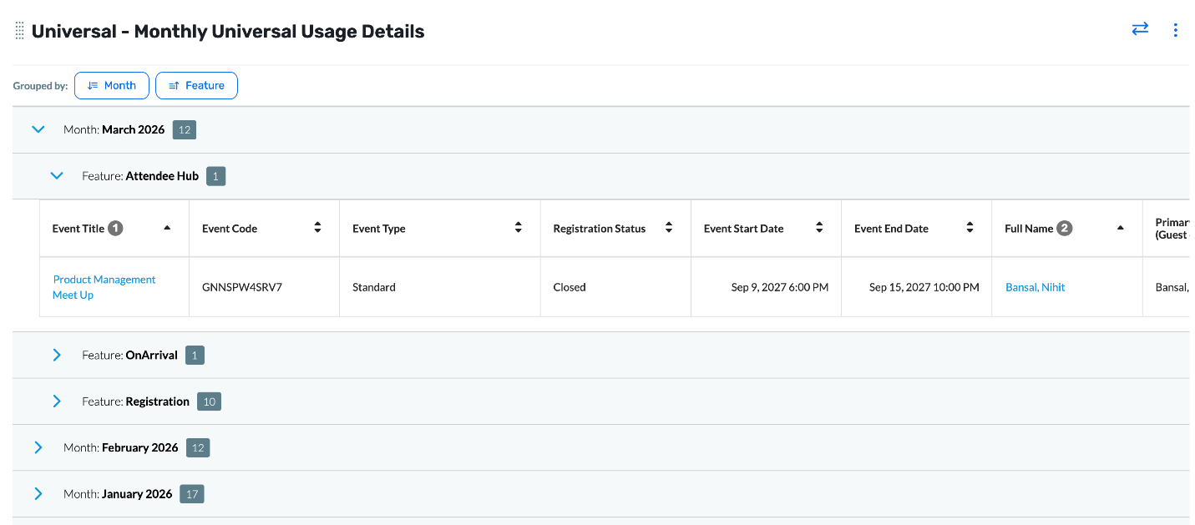
7
REGISTRATION
Universal Reports: Usage Details & Usage Summary
What changed: Universal Usage Details and Universal Usage Summary bring Registration, Attendee Hub, OnArrival Premium, and Essentials into one reporting experience.
Why it matters: Planners can review adoption and activity across products without stitching together multiple product-specific reports.
Use case: Run a single report to assess cross-product usage trends for the past year before deeper product-level analysis.
Link
Cvent Monthly Product News — June 2026

Slide 8
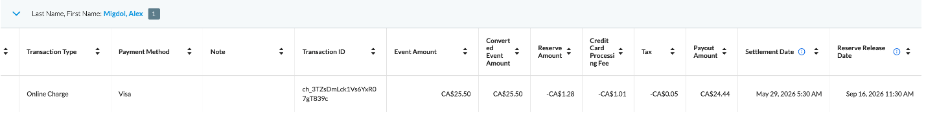
8
REGISTRATION
Cvent Payments: Transactions Details Report
What changed: A new Cvent Payments Transaction Details report adds fields such as reserve amount, processing fee, tax, payout amount, settlement date, and reserve release date.
Why it matters: Financial data that was harder to access becomes easier to use for reconciliation and reporting.
Use case: Export richer payment detail into finance workflows for payout review and month-end checks.
Link
Cvent Monthly Product News — June 2026

Slide 9
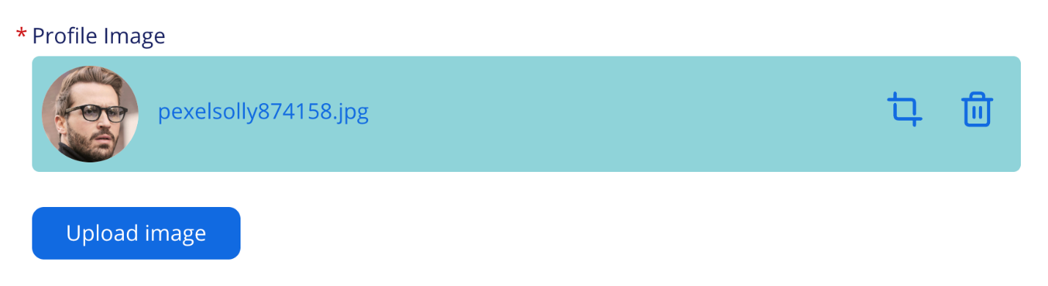
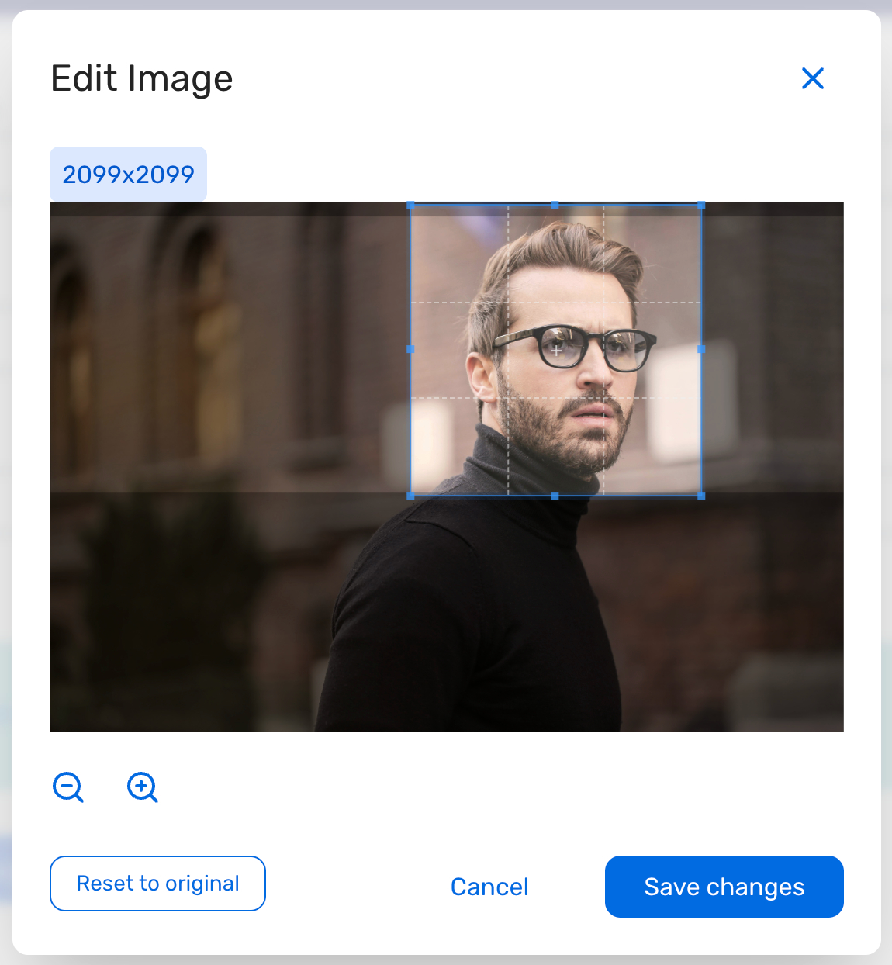
9
REGISTRATION
Profile Image Cropper
What changed: The Profile Image widget now lets attendees crop, zoom, reset, and confirm the framing of an uploaded photo before saving.
Why it matters: Better framing reduces manual cleanup and improves consistency across badges, profile surfaces, and the event app.
Use case: Especially useful when profile photos appear on badges or networking experiences and image quality matters.
Link
Cvent Monthly Product News — June 2026

Slide 10
10
EXHIBITOR MANAGEMENT
Exhibitor Custom Field Visibility
What changed: Custom fields can now be set as visible to all exhibitors, visible only to selected exhibitors, read-only, or visible only to planners.
Why it matters: Teams can collect the right data without cluttering the exhibitor experience or exposing planner-only operational details.
Use case: Show only the fields that matter to specific exhibitors while keeping planner-only notes out of the Exhibitor Portal and Attendee Hub.
Link
Cvent Monthly Product News — June 2026

Slide 11
11
EXHIBITOR MANAGEMENT
Question Code for Custom Fields
What changed: Each Exhibitor Custom Field now supports a unique Question Code that can be auto-generated or customized.
Safer imports,
clear identifiers
Why it matters: Teams can support fields with similar display names while making imports more reliable and easier to manage.
Use case: Use Question Codes when importing exhibitor data or when multiple fields need similar names but distinct identifiers.
Link
Cvent Monthly Product News — June 2026

Slide 12

12
Attendee Engagement
Attendee Hub, Events+, Appointments, OnArrival, LeadCapture, Webinar, Essentials
Cvent Monthly Product News — June 2026

Slide 13
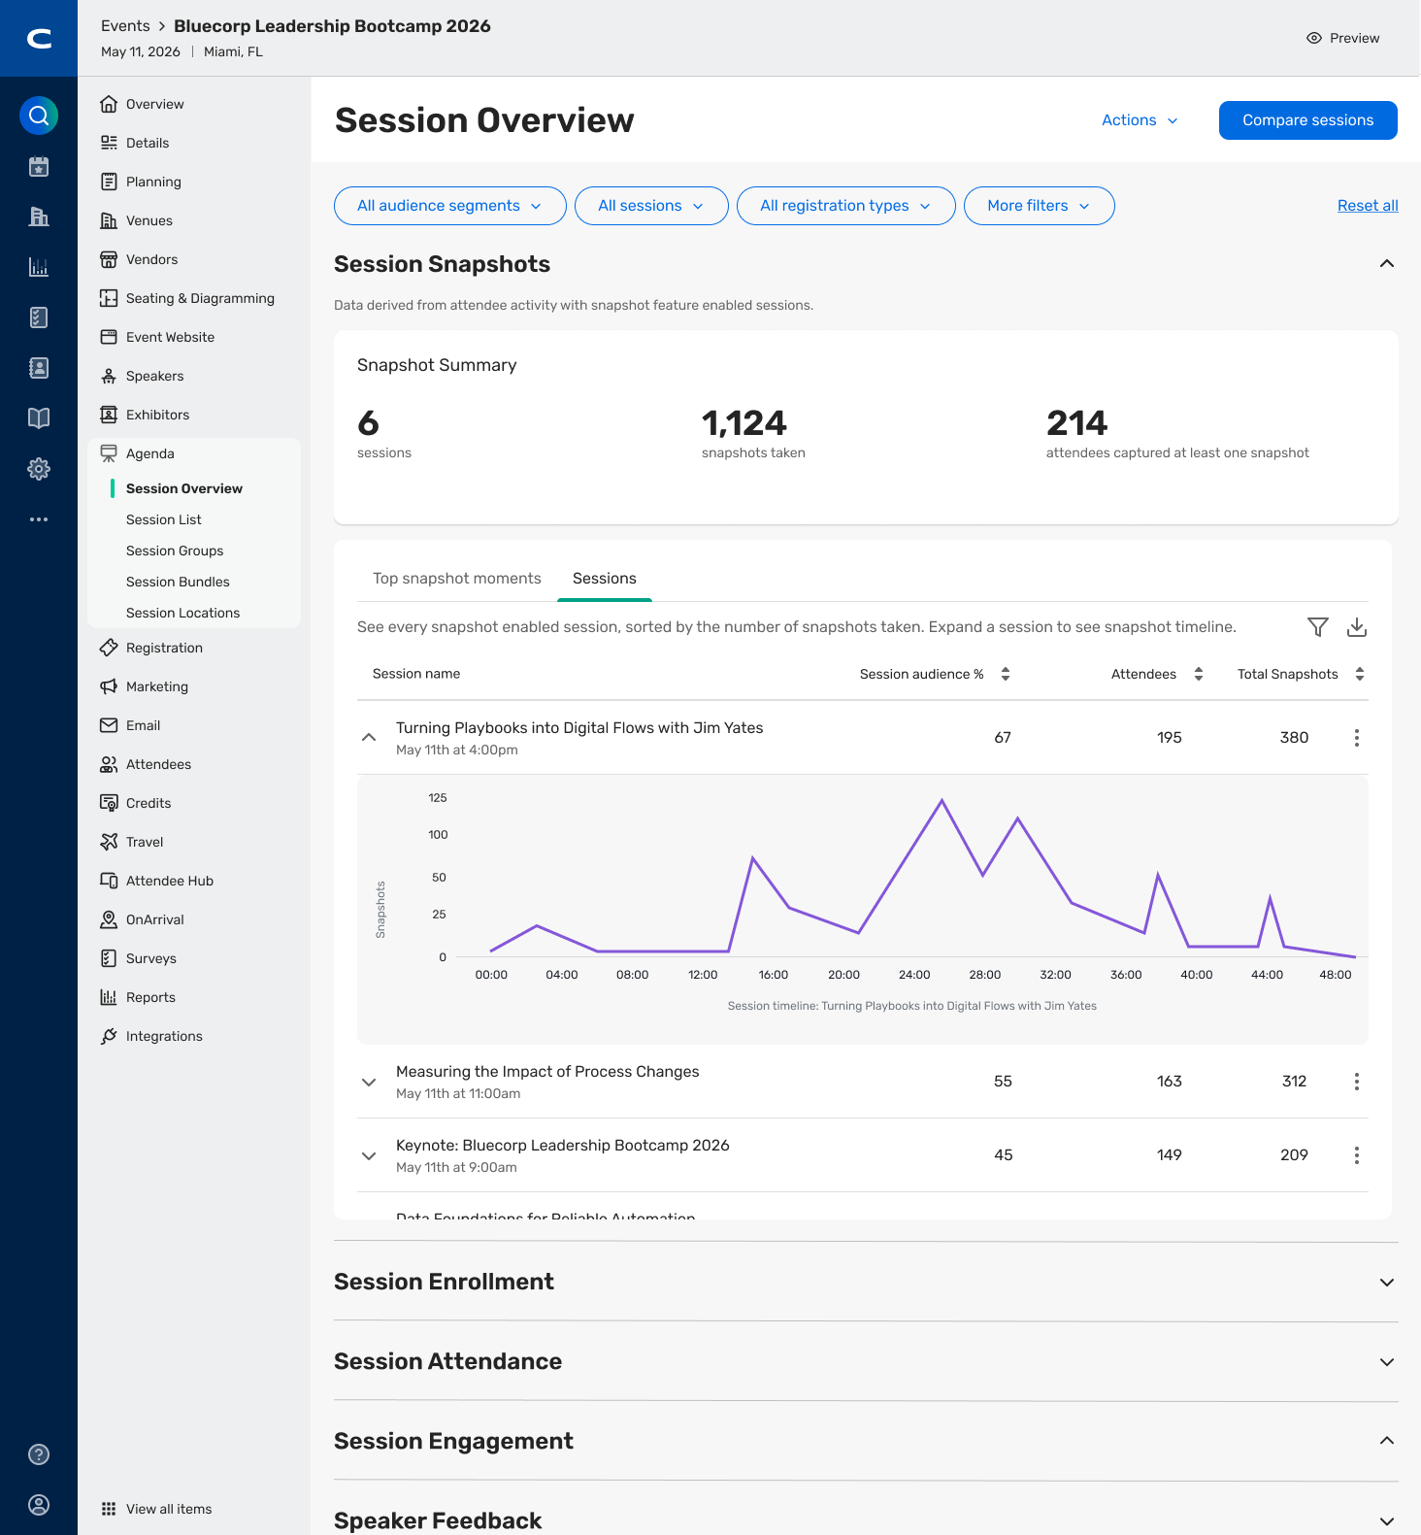
13
ATTENDEE HUB
Session Snapshots Insights
What changed: The new insights view highlights top snapshot moments across the event, usage by session, and a timeline of when snapshots were taken.
Why it matters: Teams get clearer visibility into content engagement and where audience attention was highest.
Use case: Use snapshot patterns to evaluate sessions and refine future agenda planning.
Link
Cvent Monthly Product News — June 2026

Slide 14
14
ATTENDEE HUB
'My updates' Modernization in Event App
What changed: The Event App now supports swipe interactions and bulk dismiss actions for notifications in My Updates.
Faster mobile
updates
Why it matters: Attendees can review important updates faster through a more familiar and efficient mobile pattern.
Use case: Helpful for busy event schedules where attendees need to triage alerts quickly while on the move.
Link
Cvent Monthly Product News — June 2026

Slide 15
15
ESSENTIALS & WEBINAR
Registration Question Tags
What changed: Organizers can tag registration questions for each event or reuse tags from the Question Tags Library.
Tag once,
report better
Why it matters: Consistent tagging supports cleaner cross-event reporting, smoother integrations, and less manual data reconciliation.
Use case: Tag recurring lead or program questions once and compare responses across multiple events with less cleanup.
Link
Cvent Monthly Product News — June 2026

Slide 16
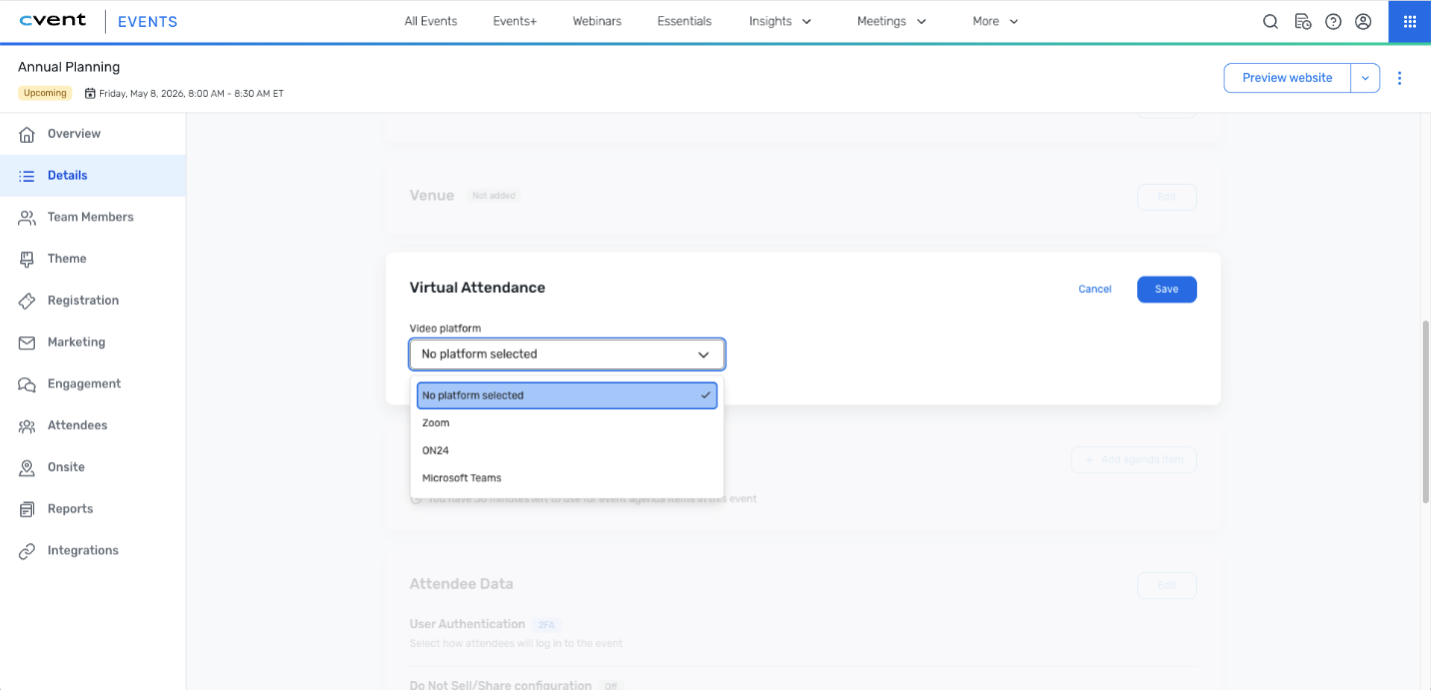
16
ESSENTIALS
Virtual Attendance
What changed: Essentials events can add a virtual component using Zoom, ON24, or Microsoft Teams while managing registrations, communications, join links, and attendance in one place.
Why it matters: Teams can run hybrid programs without stitching together separate tools for registration and online attendance.
Use case: Add a virtual option to a field event and still manage reminders, access details, and attendance centrally.
Link
Cvent Monthly Product News — June 2026

Slide 17
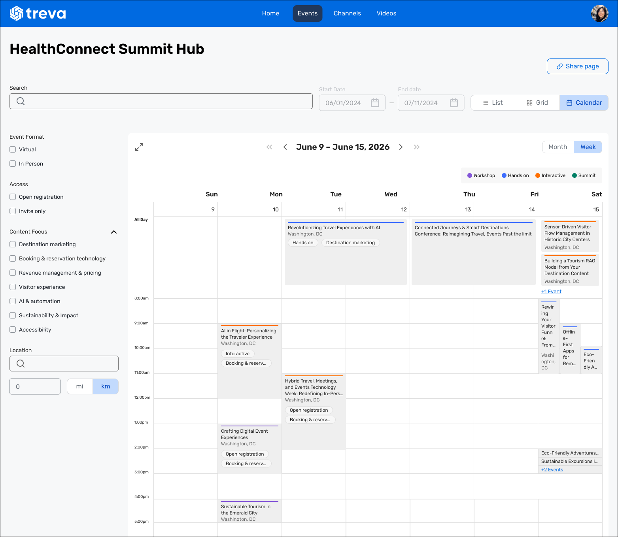
17
ATTENDEE HUB / EVENTS+
Calendar View In Event Calendar
What changed: Events+ calendars can use Calendar View as the default layout, with month/week browsing and the ability to switch between Calendar, List, and Grid views.
Why it matters: Calendar-style browsing makes event content feel more organized and easier to scan.
Use case: Use Calendar View when attendees need to understand programming by date and quickly navigate what is happening next.
Link
Cvent Monthly Product News — June 2026

Slide 18
18
REGISTRATION
REST API for Event Vouchers
What changed: New read-only REST API support makes it possible to retrieve voucher data and track which attendees used a specific voucher.
Voucher data,
via API
Why it matters: Teams can support reporting, reconciliation, and external integrations without relying only on UI-based voucher visibility.
Use case: Pull voucher usage data into an external reporting or reconciliation process for better operational visibility.
Link
Cvent Monthly Product News — June 2026

Slide 19
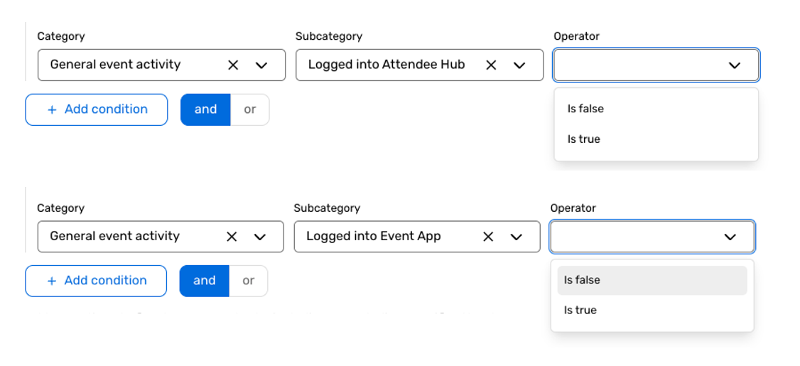
19
ATTENDEE HUB
Absence-Based Targeting in Dynamic Audience Segments
What changed: Dynamic Audience Segments can now be built from actions attendees have not taken, such as not logging in, not attending a session, or not joining chat.
Why it matters: Self-updating segments make it easier to identify engagement gaps and trigger timely follow-up without manual list comparison.
Use case: Create a live audience segment for attendees who have not taken a desired action and send a targeted reminder.
Link
Cvent Monthly Product News — June 2026

Slide 20
20
EVENTS+
Automated Video Publishing
What changed: Teams can choose an Events+ Hub and up to five channels for pre-recorded session videos, then publish automatically right away or after the event ends.
Publish video
with less work
Why it matters: Video distribution becomes more consistent while reducing setup and wrap-up work across products.
Use case: Queue session videos to publish automatically so on-demand content is available faster after the event.
Link
Cvent Monthly Product News — June 2026

Slide 21
21
ONARRIVAL
Hybrid Check-in Improvements
What changed: Hybrid attendance counts now reflect actual participation more accurately, and attendees who joined virtually can still be checked in onsite.
More accurate
hybrid counts
Why it matters: Planners get cleaner hybrid attendance data while supporting flexible attendee journeys.
Use case: Check in an attendee onsite even after they participated virtually earlier in the day without disrupting reporting.
Link
Cvent Monthly Product News — June 2026

Slide 22

22
Actionable Insights
Surveys, Reporting, Integrations, Engagement Scoring, App Marketplace
Cvent Monthly Product News — June 2026

Slide 23
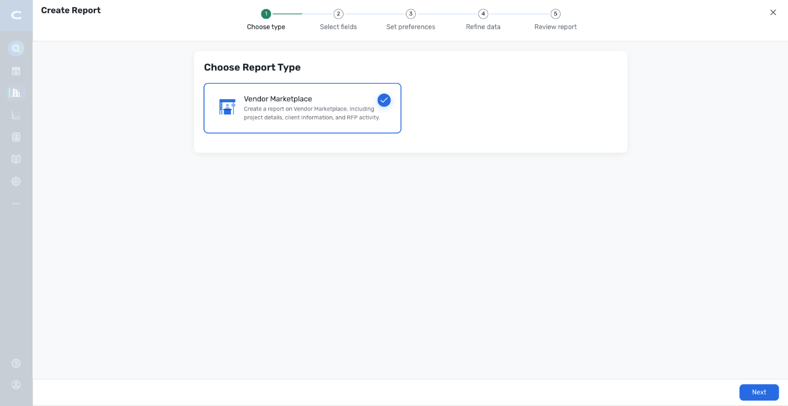
23
REPORTING
Introducing Vendor Marketplace Reports
What changed: Planners can create dynamic, customizable vendor reports using Project, RFP, Quote, or Client information.
Why it matters: Teams can tailor reporting to their needs while respecting existing Reposite permission levels.
Use case: Build a recurring commission, costing, or RFP report without assembling multiple exports every time.
Link
Cvent Monthly Product News — June 2026

Slide 24
24
REPORTING
Cross Event Feedback Detail Report
What changed: Question tags now persist independently of event selection in the Cross Event Feedback Detail report.
Reports that
stay configured
Why it matters: Saved reports stay more reliable when dynamic date filters change which events are included.
Use case: Keep a recurring cross-event feedback report intact from month to month without reselecting question tags.
Link
Cvent Monthly Product News — June 2026

Slide 25
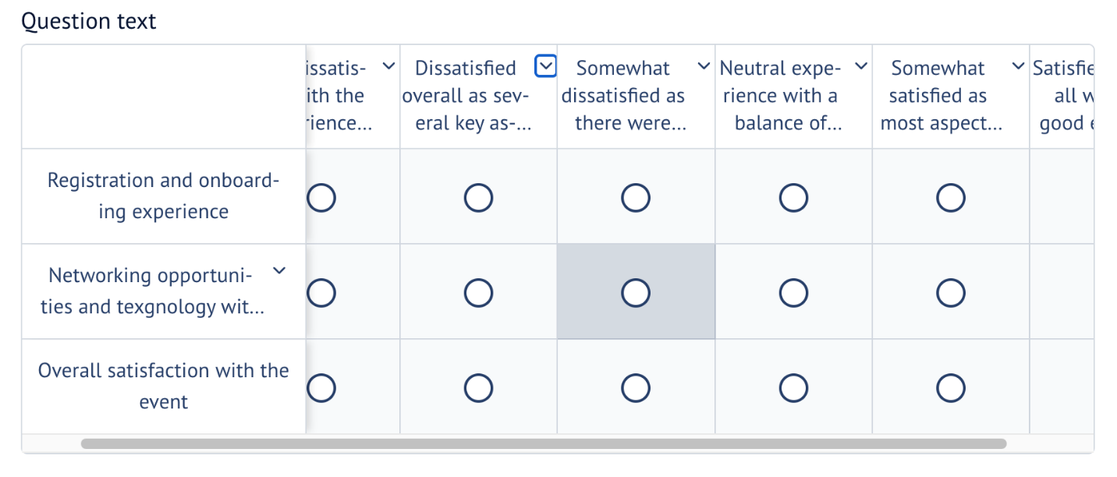
25
SURVEYS
Matrix Question Usability Enhancements
What changed: Matrix questions now use better text wrapping, adaptive layouts, sticky row labels for larger matrices, and more accessible expand/collapse controls.
Why it matters: Respondents get a cleaner, more consistent survey experience across planner and attendee surfaces.
Use case: Design more detailed matrices with greater confidence that labels and controls will remain readable.
Link
Cvent Monthly Product News — June 2026

Slide 26

26
Exchange Solutions
Cvent Supplier Network, Event Diagramming, Passkey, Cvent Travel, Instant Book, Vendor Marketplace powered by Reposite
Cvent Monthly Product News — June 2026

Slide 27
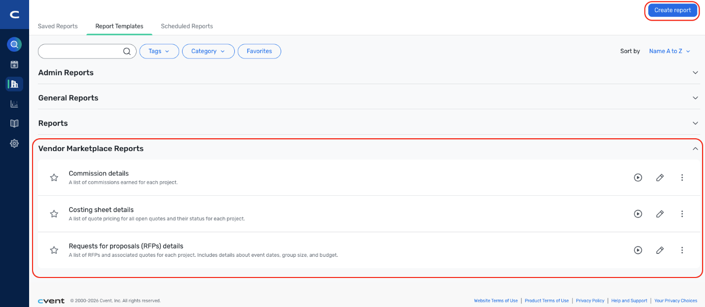
27
VENDOR MARKETPLACE POWERED BY REPOSITE
Introducing Vendor Marketplace Reports
What changed: Teams can use ready-to-go templates, create custom vendor reports, save them, and schedule them using Project, RFP, Quote, or Client data.
Why it matters: Sourcing teams get more control over vendor reporting while access still respects existing Reposite permission settings.
Use case: Build a recurring commission, costing, or RFP report without assembling multiple exports every time.
Link
Cvent Monthly Product News — June 2026

Slide 28
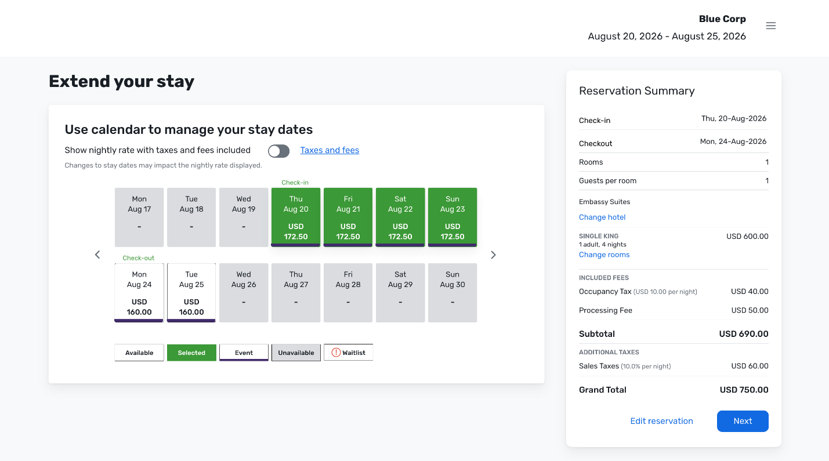
28
CVENT PASSKEY
Processing Fees Now Appear in Included Fees
What changed: Processing fees now appear in the Included Fees section of the Reservation Summary instead of separately below the Grand Total.
Why it matters: Attendees get a cleaner, easier-to-understand cost summary during checkout.
Use case: Reduce confusion when attendees review reservation charges before booking.
Link
Cvent Monthly Product News — June 2026

Slide 29
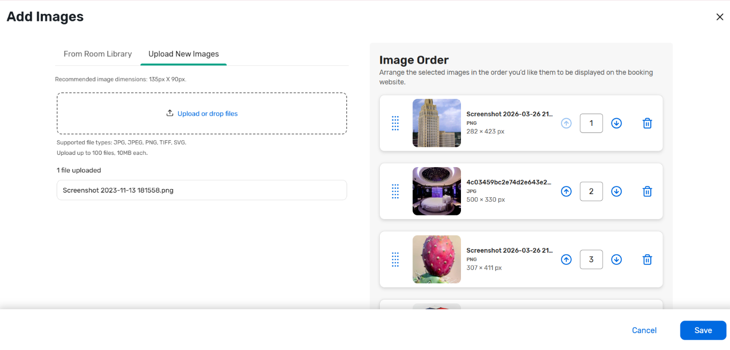
29
CVENT PASSKEY
Upload Room Category Images
What changed: Event owners can upload images directly to room categories from both the hotel library and the event setup level.
Why it matters: Room categories can be represented more clearly, helping reduce mismatched expectations during booking.
Use case: Show room category visuals that better distinguish premium and standard options on the booking site.
Link
Cvent Monthly Product News — June 2026

Slide 30
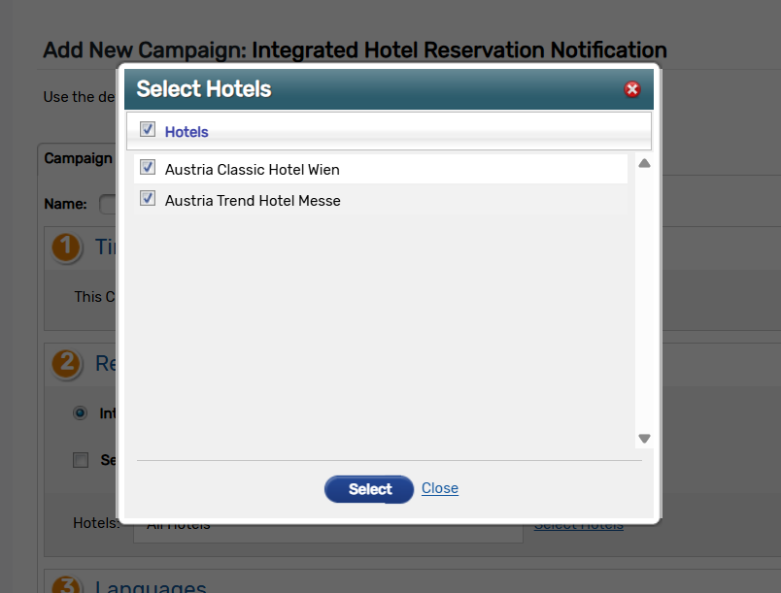
30
CVENT PASSKEY
Integrated Hotel Reservation Alerts
What changed: A new hotel reservation notification campaign adds more precise targeting, reservation-focused content, setup guidance, refreshed templates, and campaign reporting.
Why it matters: Teams can send clearer reservation communications to the right hotel partners and reduce missed follow-up.
Use case: Notify only impacted hotel partners when a reservation needs action and track campaign performance afterward.
Link
Cvent Monthly Product News — June 2026

Slide 31
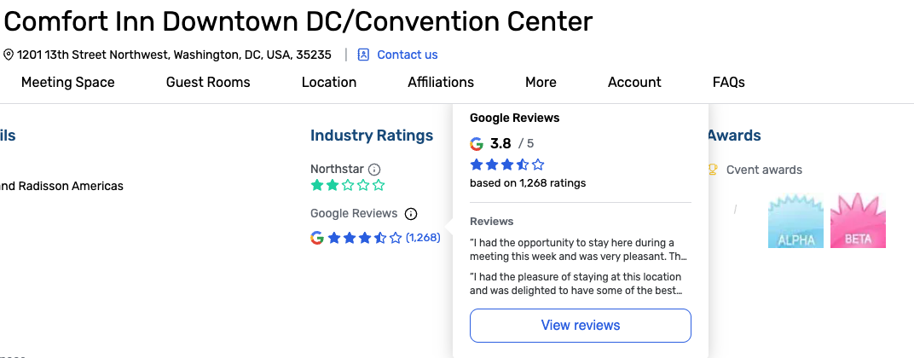
31
CVENT SUPPLIER NETWORK
Google Reviews & Ratings on Venue Profiles
What changed: Venue Profiles in CSN now show Google ratings, review counts, hover details, and a View Reviews experience with up to five reviews.
Why it matters: Planners can validate venue quality with trusted outside sentiment without leaving the sourcing workflow.
Use case: Compare shortlisted venues faster by reviewing Google feedback alongside existing industry ratings.
Link
Cvent Monthly Product News — June 2026

Slide 32
32
CVENT TRAVEL
Streamlined Login via Single Sign-On (SSO)
Login with SSO
Familiar sign-in through existing identity controls
What changed: Buyers and travel managers can sign in to Cvent Travel using their existing corporate identity provider.
Why it matters: Organizations can offer a familiar sign-in experience while applying existing access controls.
Use case: Enable corporate credentials for travel teams so adoption is easier and account access is more consistent.
Link
Cvent Monthly Product News — June 2026

Slide 33
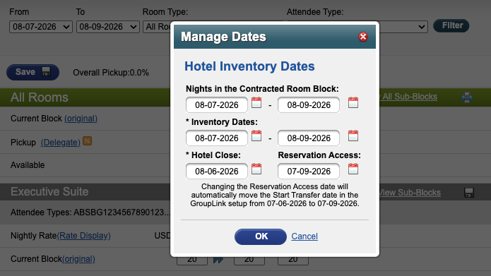
33
CVENT PASSKEY
Start Transfer Dates Stay In Sync
What changed: When a hotel’s Reservation Access date changes, the related Start Transfer date now updates automatically to keep the same timing offset.
Why it matters: Reservation availability and transfer timing stay in sync after date changes, reducing manual follow-up.
Use case: Adjust cutoff or reservation-access dates without manually reconciling related transfer timing.
Link
Cvent Monthly Product News — June 2026

Slide 34
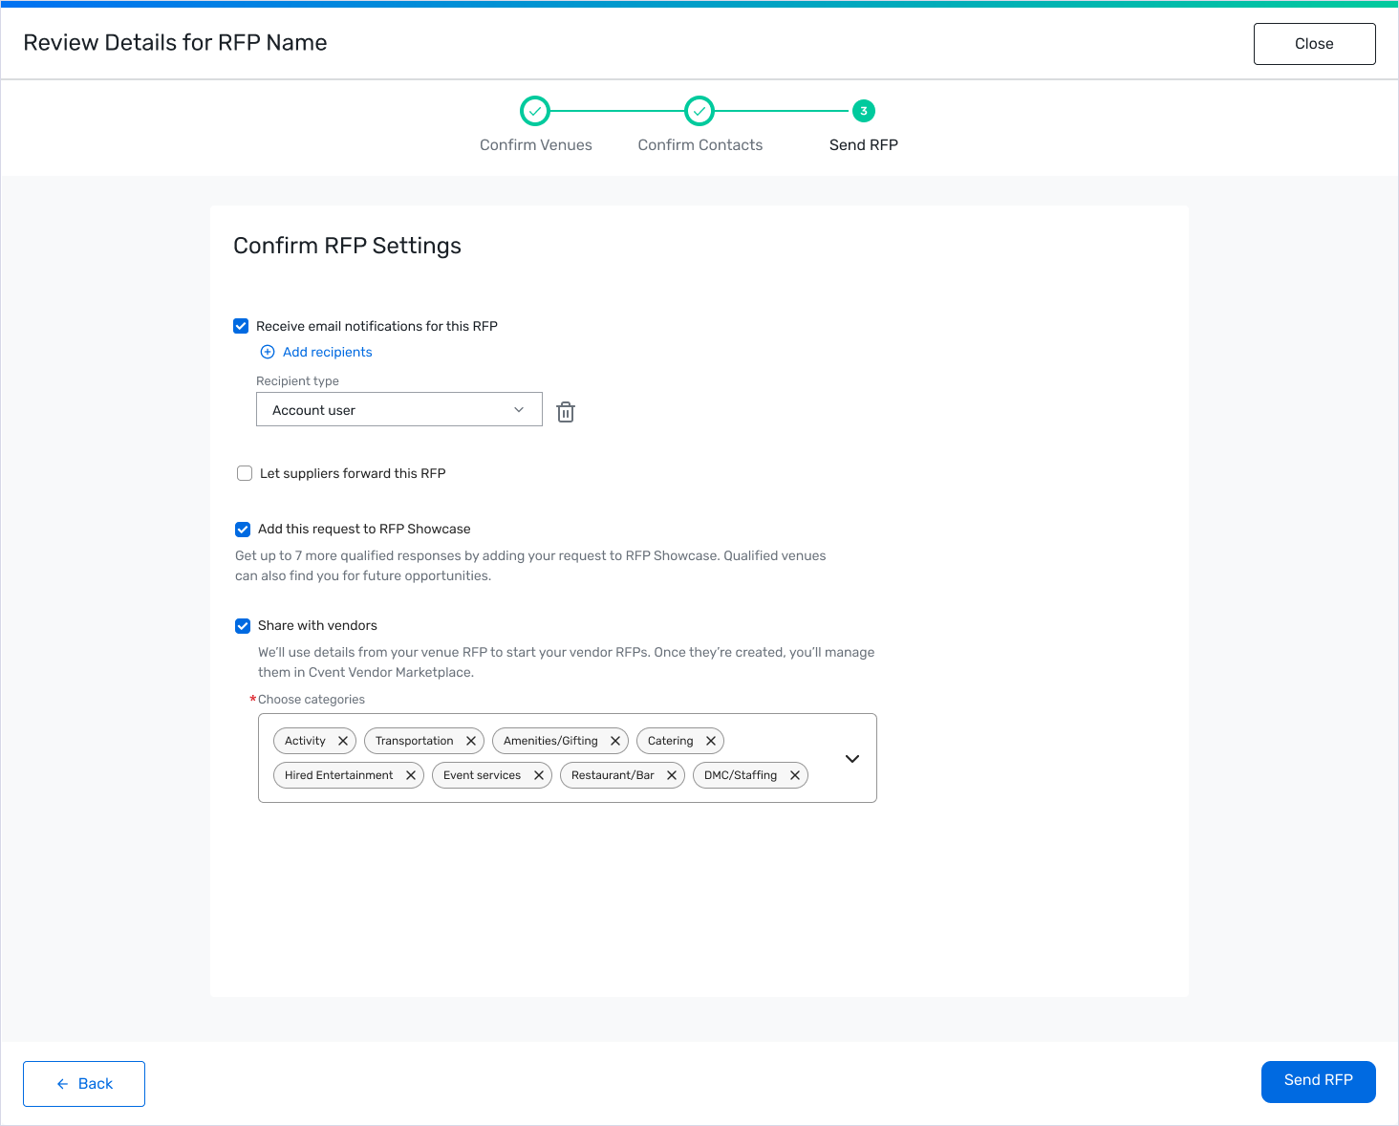
34
VENDOR MARKETPLACE POWERED BY REPOSITE / REPOSITE VENDOR SHOWCASE 2.0
Create and Manage Vendor RFPs in the CSN Planner Experience
What changed: Planners can opt into vendor sourcing during the CSN RFP flow, continue into vendor RFP creation, and manage live vendor activity from a dedicated Vendors tab.
Why it matters: Venue and vendor sourcing become a more connected workflow with less manual handoff between systems.
Use case: Move from venue sourcing into vendor sourcing while keeping status, actions, and sync behavior visible in one place.
Link
Cvent Monthly Product News — June 2026

Slide 35

35
Spend & Workflow
Budget Management, Meeting Request Form, Access Portal
Cvent Monthly Product News — June 2026

Slide 36
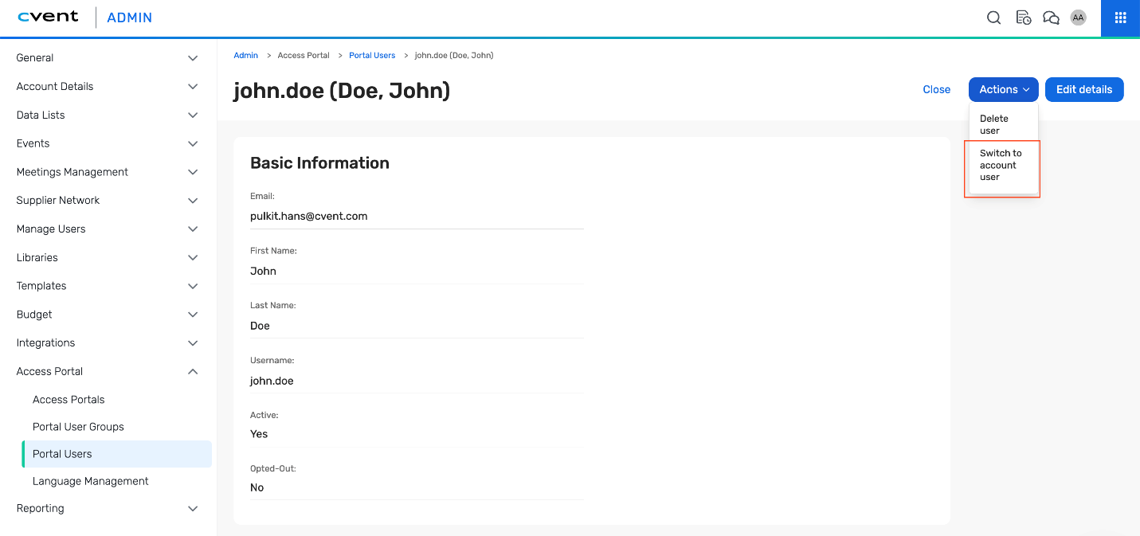
36
ACCESS PORTAL
Convert Access Portal Users to Account Users
What changed: Admins and Portal Managers can convert an Access Portal User into an Account User directly from the portal user overview page.
Why it matters: User access can expand as responsibilities grow while memberships, submitted requests, reports, and other portal content stay intact.
Use case: Promote an external collaborator into a fuller account role without recreating their access from scratch.
Link
Cvent Monthly Product News — June 2026

Slide 37

37
Trade Show Solutions
iCapture, Jifflenow
Cvent Monthly Product News — June 2026

Slide 38
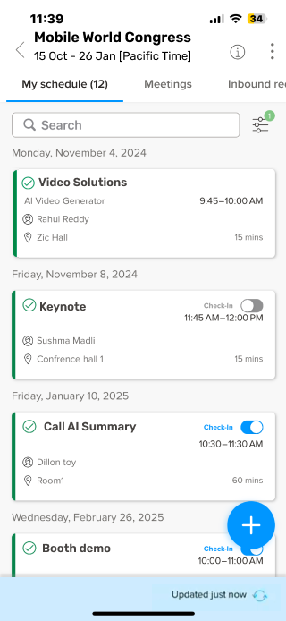
38
JIFFLENOW
My Schedule on Jifflenow Mobile App
What changed: Jifflenow mobile now opens to a personalized My Schedule view for requestors, attendees, and executive assistants.
Why it matters: Users can confirm what is next with fewer taps, which is especially helpful onsite.
Use case: Give participants a faster way to see their own meetings and sessions the moment they open the app.
Link
Cvent Monthly Product News — June 2026

Slide 39
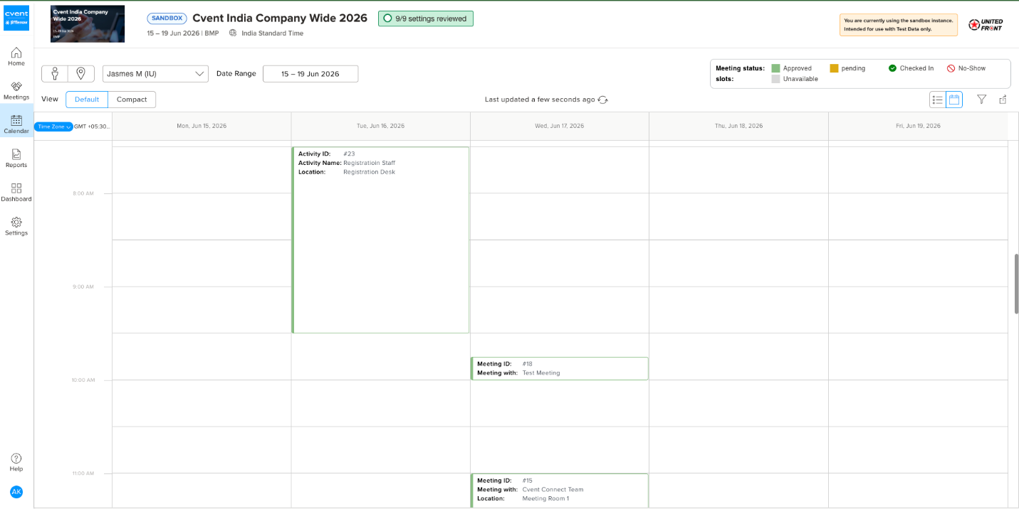
39
JIFFLENOW
Staff Scheduling
What changed: Staff Scheduling is built into eEvent as an Activity engagement type with a dedicated Activities tab and a unified calendar.
Why it matters: Organizers can manage staff activities and customer meetings from one workflow instead of separate tools.
Use case: Schedule booth staff shifts and customer meetings side by side for better onsite coordination.
Link
Cvent Monthly Product News — June 2026

Slide 40
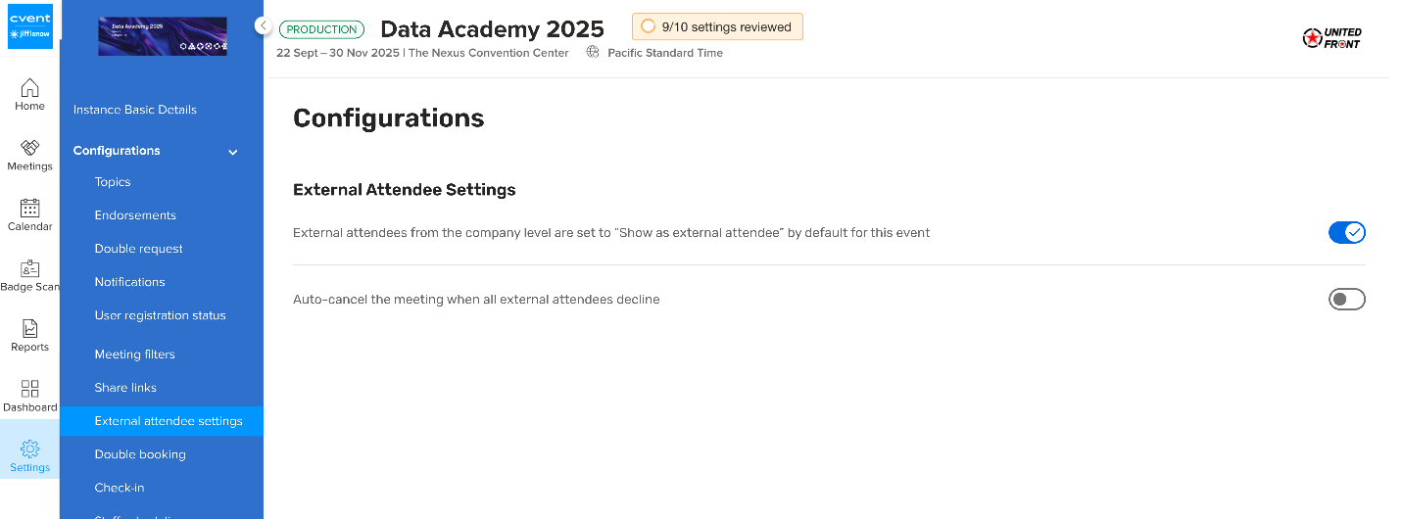
40
JIFFLENOW
Automatic Meeting Cancellation
What changed: A new event-level setting can automatically cancel meetings when all external attendees decline, with traceability in Meeting History.
Why it matters: Scheduling cleanup becomes lighter while teams retain control and a clear system-generated audit trail.
Use case: Reduce manual cleanup after attendee declines during high-volume event scheduling.
Link
Cvent Monthly Product News — June 2026

Slide 41
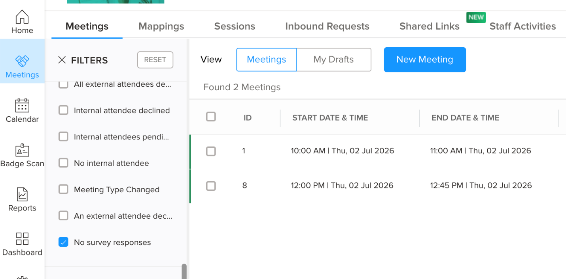
41
JIFFLENOW
New Filter: No Survey Response
What changed: A new No survey responses filter under Meeting Needs Attention finds meetings with exactly zero filled survey responses.
Why it matters: Teams can identify feedback gaps faster without cross-checking reports against meeting records manually.
Use case: Quickly build a follow-up list for meetings that still need post-event survey outreach.
Link
Cvent Monthly Product News — June 2026

Slide 42

June 2026 wrap-up
A quick summary of the June product updates included in this deck.
Plan & Promote
Exchange Solutions
Admin self-service, event discovery, reporting, profile capture, voucher APIs, and exhibitor data governance.
Improved Reposite workflows, clearer Passkey experiences, Travel SSO, and richer venue intelligence.
Attendee Engagement
Spend & Workflow
Stronger insights, easier mobile engagement, better hybrid support, improved segmentation, and automated publishing.
Focused operational improvement for Access Portal user conversion.
Actionable Insights
Trade Show Solutions
More flexible reporting, better survey usability, and integration-ready voucher data.
Jifflenow execution improvements across schedule visibility, staffing, cancellations, and survey follow-up.

Slide 43
Thank You!

