Slide 1


YOUR PATH TO SUCCESS
Notes:
Conference Call etiquette:
Mute your phone. A few minutes will be left at the end of this call for questions.
The goal of new member orientation is to provide you with a general overview of many of the benefits offered to our members in order for you to develop a plan to make your membership experience meet your expectations. I often like to refer to MPI as if it was a gym membership. You have to show up, participate, and continue to come back in order to see the results you desire.

Slide 2
Getting to Know MPI
Meeting Professionals International (MPI) is the largest and most vibrant global meeting and event industry association. The organization helps its members thrive by building human connections through knowledge and ideas, relationships, and marketplaces. MPI membership is comprised of approximately 18,500 members belonging to 70 chapters and clubs in 22 countries worldwide.
Visit www.mpiweb.org
Notes:
Meeting Professionals International begin in 1972 by Robert (Buzz) Bartlow. 159 charter members came together to share their knowledge on planning meetings and events and talk about the advancement of this profession. That same year the very first MPI chapter was established which was the Rocky Mountain Chapter.

Slide 3
MPI Vision and Mission
Mission
To provide MPI members, chapters and the global meeting and event community with innovative and relevant education, networking opportunities, business exchanges, and to act as a prominent voice for the promotion and growth of the industry
Notes:
Our members plan

Slide 4
MPI Global Benefits
Notes:
All members receive benefits provided by the global headquarters in Dallas, Texas and the local chapter you affiliated with. We will review a few of these benefits today.

Slide 5
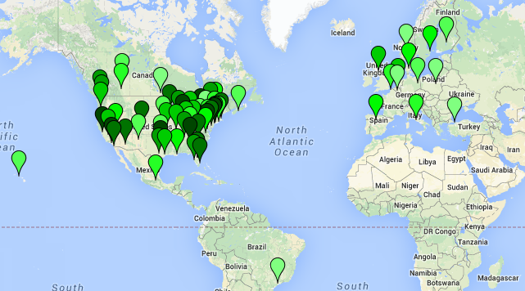
Chapter Affiliation
Meet local colleagues
and potential clients
Attend networking or special events, seminars, regional conferences, certification study groups
Local educational opportunities
And more…
Notes:
Chapters are required to have at least 6 events per year.

Slide 6
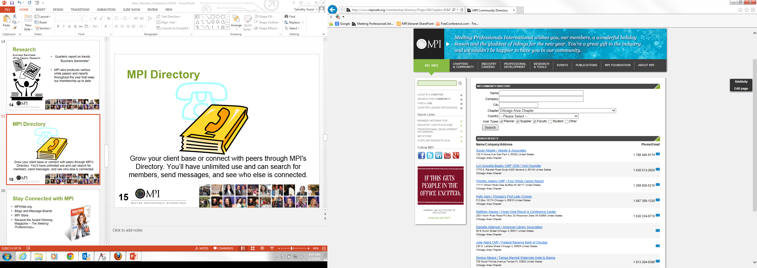
MPI Member Directory
Grow your client base or connect with peers through MPI's Directory. You’ll have unlimited use and can search for members, send messages, and see who else is connected.
http://www.mpiweb.org/Membership/Directory

Slide 7
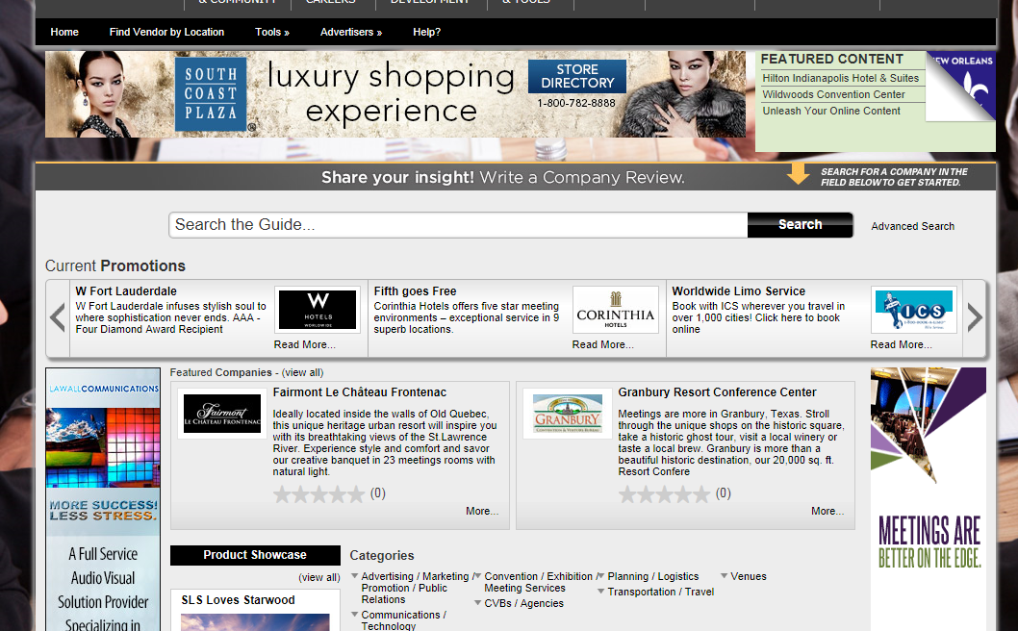
MPI Supplier Marketplace
Comprehensive guide to finding everything you would need to plan a meeting or event around the world!

Slide 8

MPI’s Family of Publications
Award-winning magazine
The Meeting Professional™
MPIWeb.org
MPIpulse weekly e-newsletter
MPIspotlight bi-weekly e-newsletter
Blogs and Message Boards

Slide 9

Recently launched
Members get MPI Verified speakers who are fellow members, subject matter experts, and provide discounts.

Slide 10

Notes:
Members can post new jobs, surf jobs as they are added, or even add your own resume. It’s important to remember that if you are an MPI Member who is looking for a new position, you see jobs instantly, where as non-members see them after two weeks.

Slide 11

CMM Designation Program
Joint program with Global Business Travel Association (GBTA) & MPI
First and only collaborative designation for meeting and travel professionals.
• Learn critical business skills like risk mitigation, business analytics and compliance, strategic negotiation and more.
More details at www.mpiweb.org/CMM
Notes:
CMM is like a masters degree for planners. If you current have a CMP or a CMM, I would encourage you to jot down this website so you can learn about the new CMM designation. There is a great Q&A online to answer all your questions.

Slide 12

For those who need to a broader understanding of healthcare topics.
Focus on areas such as; compliance management skills, terminology, process reporting, Transfer of Values, compliance regulations
Designed for the working adult and can be completed in 4-hour session.
Will provide you with HMCC credentials.
Notes:
CMM is like a masters degree for planners. If you current have a CMP or a CMM, I would encourage you to jot down this website so you can learn about the new CMM designation. There is a great Q&A online to answer all your questions.

Slide 13
CMP Resources
MPI is a proud supporter of the Convention Industry Council’s Certified Meeting Professional Program.
Study Groups
Professional Development on Demand
Online transcript
Discount on CMP Study Kit
Notes:
CMM is like a masters degree for planners. If you current have a CMP or a CMM, I would encourage you to jot down this website so you can learn about the new CMM designation. There is a great Q&A online to answer all your questions.

Slide 14


MPI Foundation
Grants for chapter
Professional development scholarships for members
Pan industry research
http://www.mpiweb.org/Foundation/Home
Notes:
The MPI Foundation fuels the growth and advancement of MPI members by providing them professional development and career opportunities through grants and scholarships. The MPI Foundation propels the meeting and event industry forward by funding research initiatives that support the strategic plan of MPI.

Slide 15
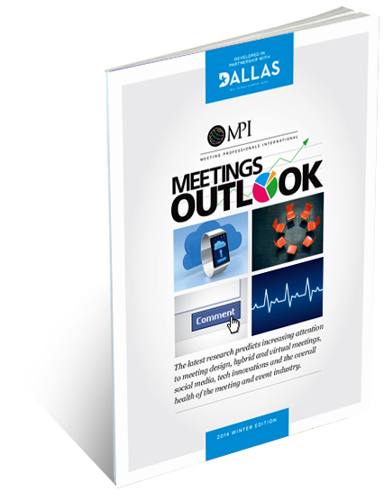
Meetings Outlook^{sm}
“Meetings Outlook” – a quarterly report on industry trends
Notes:
“Meetings Outlook” focuses on current and future trends that affect our profession and allows you to adjust your business before issues arise. This is one of the most watched quarterly reports used by executives and independent planners to help them prepare for the future.

Slide 16
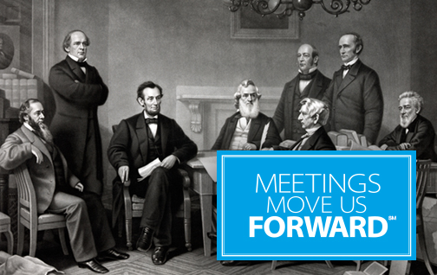
Meetings Move Us Forward™
MPI is providing you with these resources that tell the tale of what you do and why you do it. Start telling your story today!
Articles
Ad campaign
Documentary
:60 Commercial
http://www.mpiweb.org/forward

Slide 17



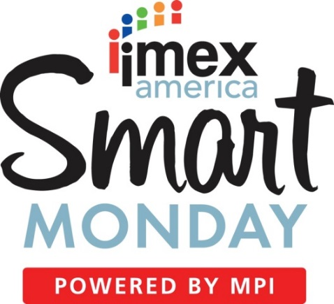


Commitment to Global Educational
Notes:
IMEX: Strategic partnership to offer professional development at IMEX.
WEC: MPI offers 60 sessions over the three day event. This event draws over 2500 attendees from all over the world each year.
MPI education can also be seen at AIBTM, HSMAI, IncentiveWorks, and many more.

Slide 18
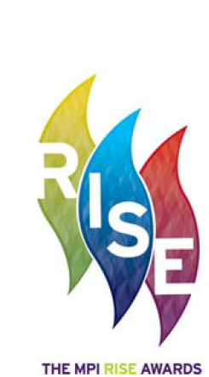
MPI RISE Awards
Recognizing
Industry
Success and
Excellence
Notes:
Three categories: Individuals, Communities, Organizations

Slide 19

Strategic Meetings Management
Complete resources at your fingertips.
Just starting
Intermediate
Advanced
http://www.mpiweb.org/Portal/Research/SMM/SMMLibrary

Slide 20
Joining MPI

Slide 21
Membership Info
Types of Members:
Planners
Suppliers
Students
Faculty
Dual Membership
Group Membership

Slide 22
Membership Pricing
 | New | Renew
Supplier | $515 | $465
Planner | $395 | $345

Slide 23
Questions

Slide 24
MPI Member Services
Hours: M-F, 8am-5pm Central
Phone: 972.702.3053
Email: feedback@mpiweb.org
30
Notes:
We want you to be successful in your first year of membership. Our Member Engagement Team here at the MPI Headquarters will be calling you throughout your first year to make sure you are making the most of your membership. Our team wants you to be successful and we will help coach you to optimize your membership experience. If you joined to network with others, we will help you understand all the opportunities available.

