Slide 1

Discover MPI

Slide 2
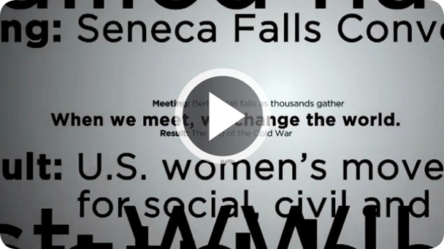

When we meet, we change the world.
http://youtu.be/BeyNb7Nft9o

Slide 3
Today’s Discussion
Overview
Leadership
MPI Foundation
Membership Value
I Am MPI
State of MPI
Open Discussion

Slide 4
Overview

Slide 5

Global Industry Impact
Meetings and Events Held Each Year
    1.83 million in the US
    1.3 million in the UK
    585,000 in Canada
Total Spending
    $280 billion in the US
    £40 billion in the UK
    $29.1 billion in Canada
Employment
    1.8 million jobs in the US
    1 million jobs in the UK
    200,000 jobs in Canada

Slide 6
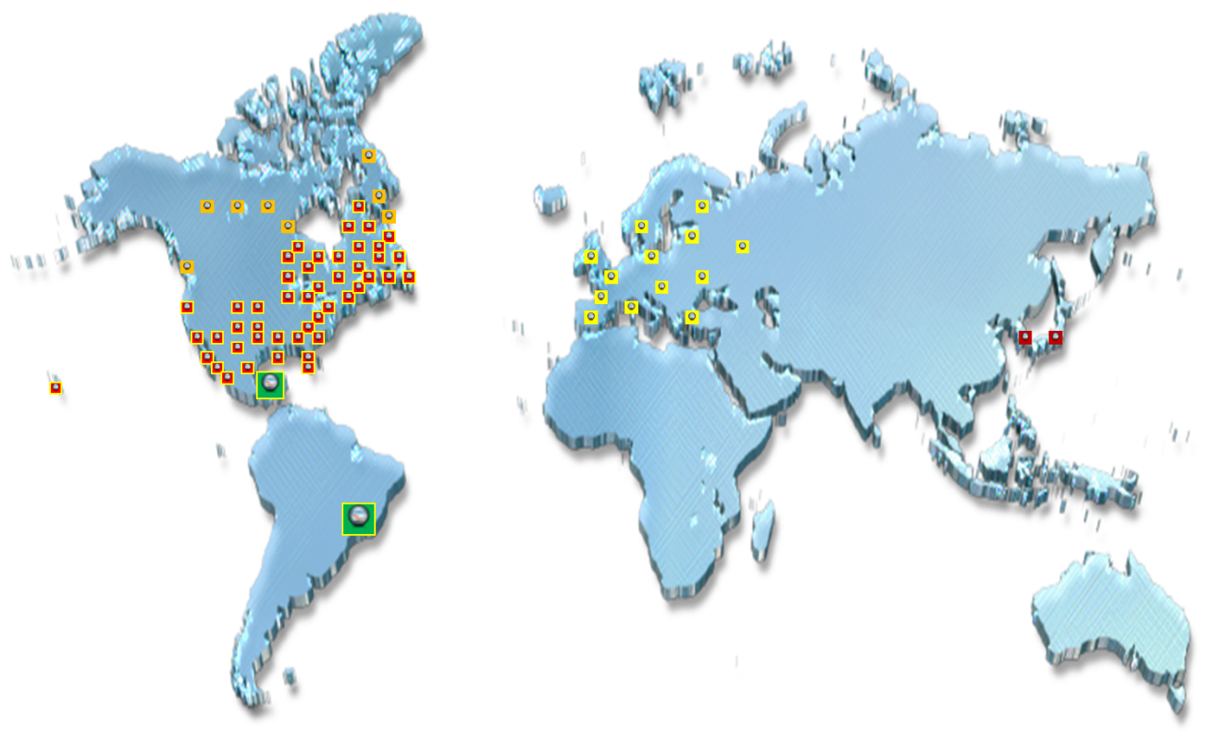
MPI Today
The largest global meeting and event industry association with 18,500 members belonging to more than 80 chapters and clubs in 22 countries.
Chapters By Region
Canada 7
U.S. 45
Latin America 2
Europe 13
Asia 2
***Plus 18 Student Clubs***

Slide 7
Strategic Focus
Vision
To be the first choice for professional career development and a prominent voice for the global meeting and event community.
Mission
To provide MPI members, chapters and the global meeting and event community with innovative and relevant education, networking opportunities and business exchanges, and to act as a prominent voice for the promotion and growth of the industry.

Slide 8
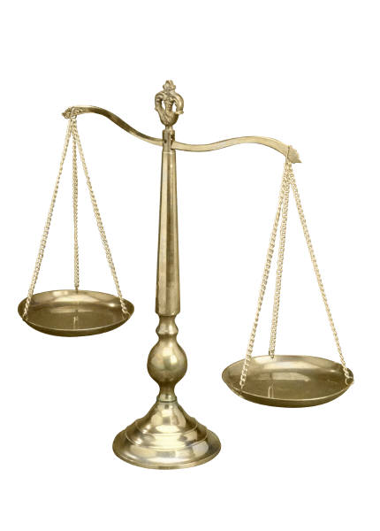
Key Facts
Founded in 1972
40+ year history
Governed by board of directors
Balanced membership representing 71 countries:
    43% planners
    46% suppliers
    9% students, faculty, etc.
    2% other
More than $22 billion in MPI global member buying power
4,800 planner members exclusive to MPI have about $11.5 billion in buying power

Slide 9



Fun Facts
22,000+ Twitter Followers
@MPI
12,000+ Facebook Fans
www.facebook.com/MPIfans
12,000+ LinkedIn Followers
www.linkedin.com/company/mpi
MPI’s Meeting & Event Discussion Group
21,000+ Members

Slide 10
Leadership

Slide 11
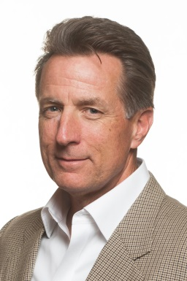
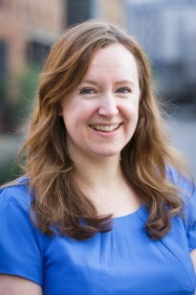
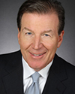
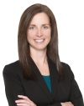
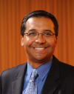
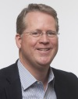

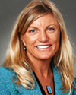
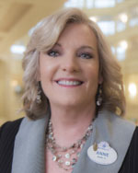
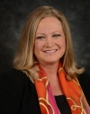
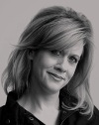

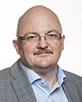
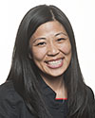
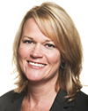


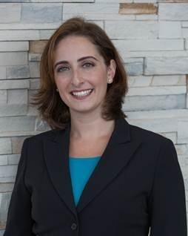
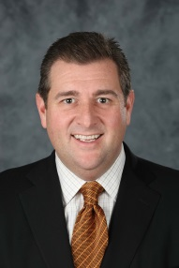
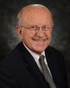
International Board of Directors
Kevin Kirby
Chair

Slide 12
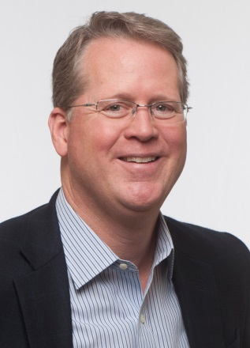
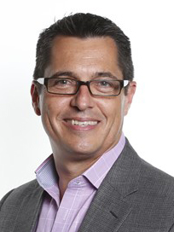
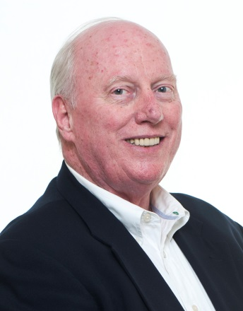
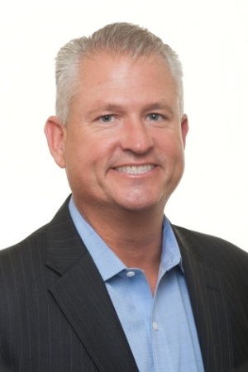
Global Team Leadership
Paul Van Deventer
President & Chief Executive Officer
Michael Woody
Chief Operations Officer
Daniel Gilmartin
Chief Financial Officer
Darren Temple
Chief Business Development Officer

Slide 13
MPI Foundation

Slide 14


Slide 15
Supporting the Industry
Purpose
The Meeting Professionals International Foundation (MPIF) is a not-for-profit organization that shall fund grants, scholarships and pan-industry research in support of the global meeting and event industry.
Mission
The MPI Foundation funds education and pan-industry research that drive the success of meeting professionals.

Slide 16


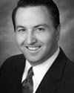
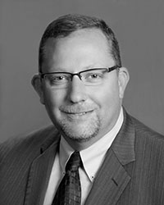
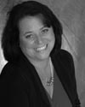

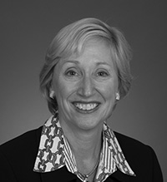
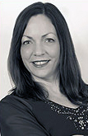
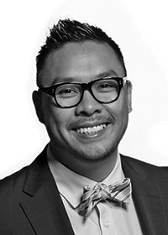
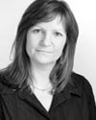
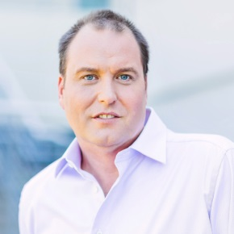
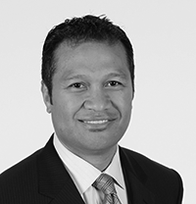
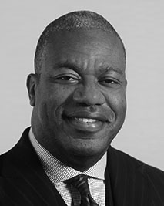
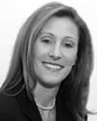
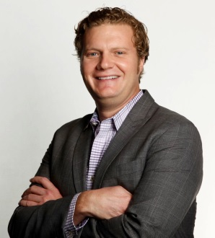
Global Board of Trustees
Stephen Revetria
Chair
Plus two more trustee members…
Tony Fundaro
Sr. Director of Development
MPI Global Team

Slide 17

Annual Report
Nearly $1 million total funds distributed towards grants, scholarships and research since 2014.

Slide 18
Grants & Scholarships
Awarded 75 scholarships and 22 chapter grants in 2014.
So far this year, awarded 91 scholarships and 6 chapter grants as of August 1st.
More opportunities available, apply today at www.mpiweb.org/foundation.

Slide 19
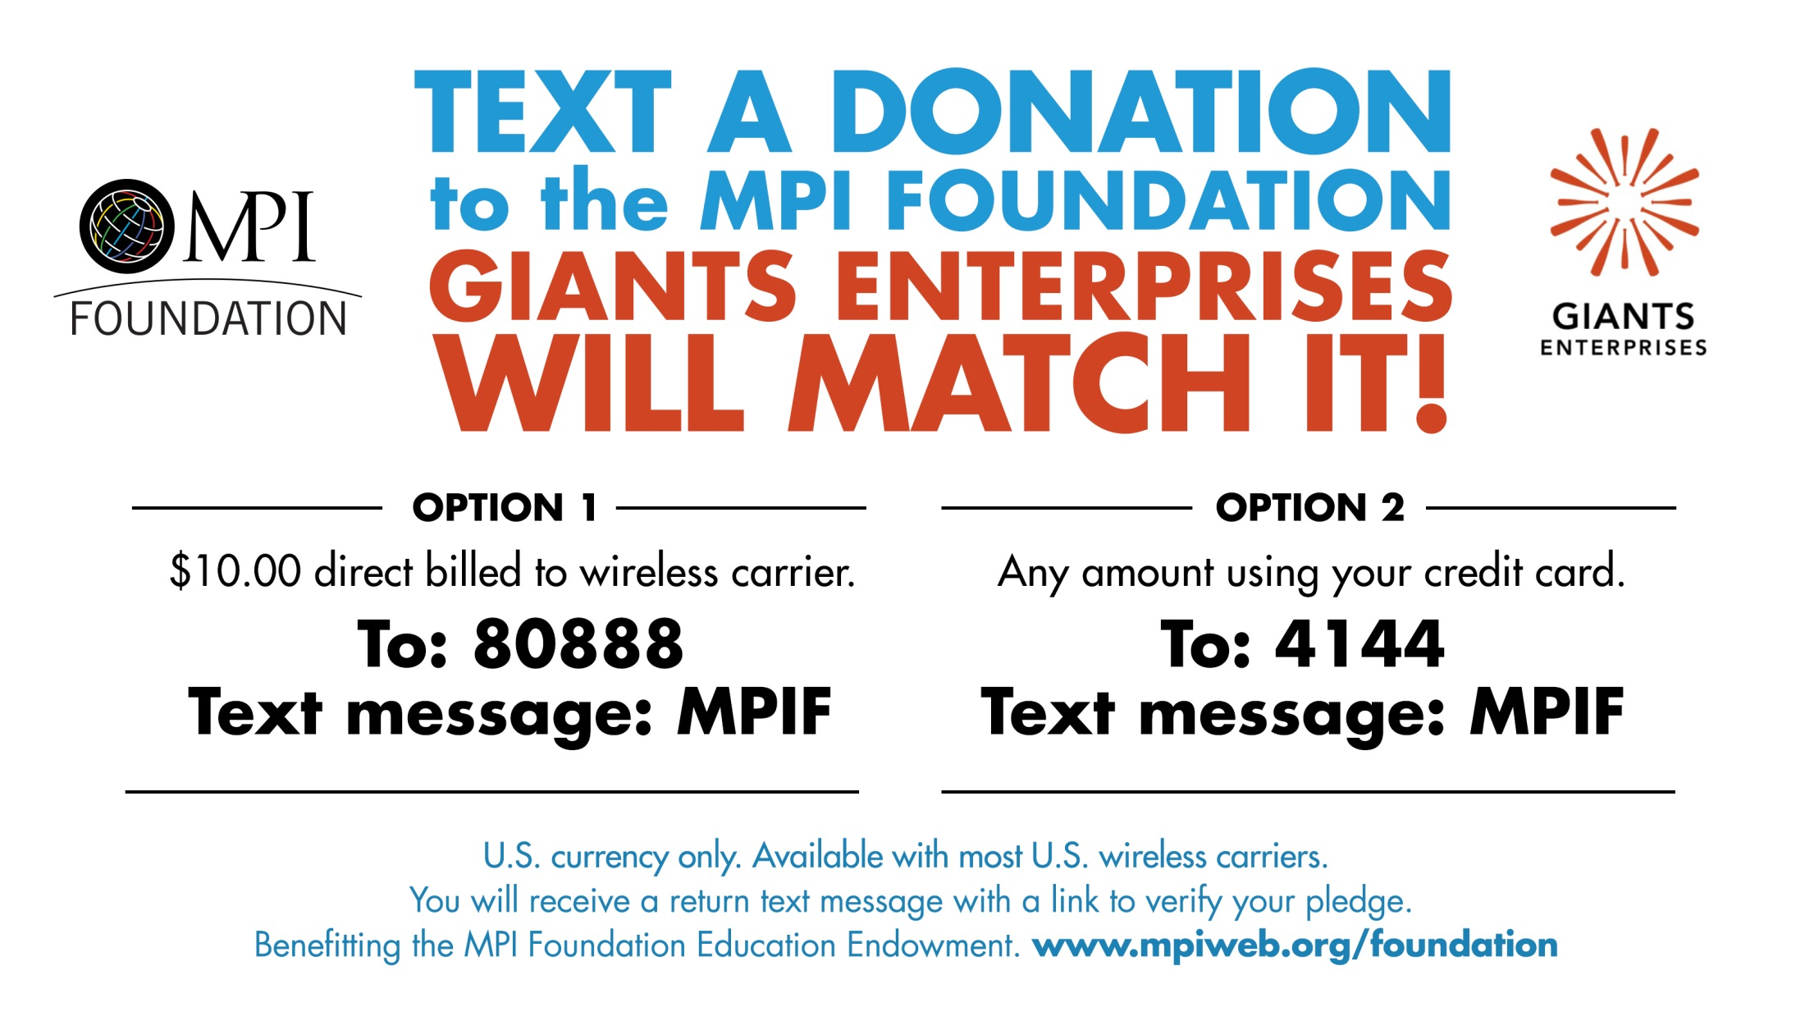

Slide 20
Membership Value

Slide 21
Core Value Proposition
Professional Development
Education
Networking
Business
Marketplace
Industry
Voice

Slide 22



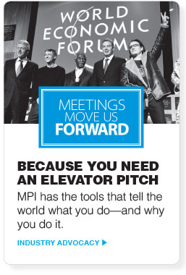
Membership ROI

Slide 23

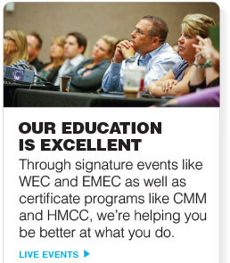
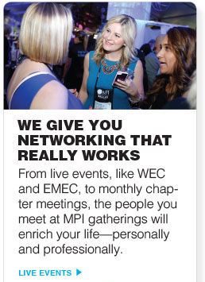
Membership ROI

Slide 24




Membership ROI

Slide 25
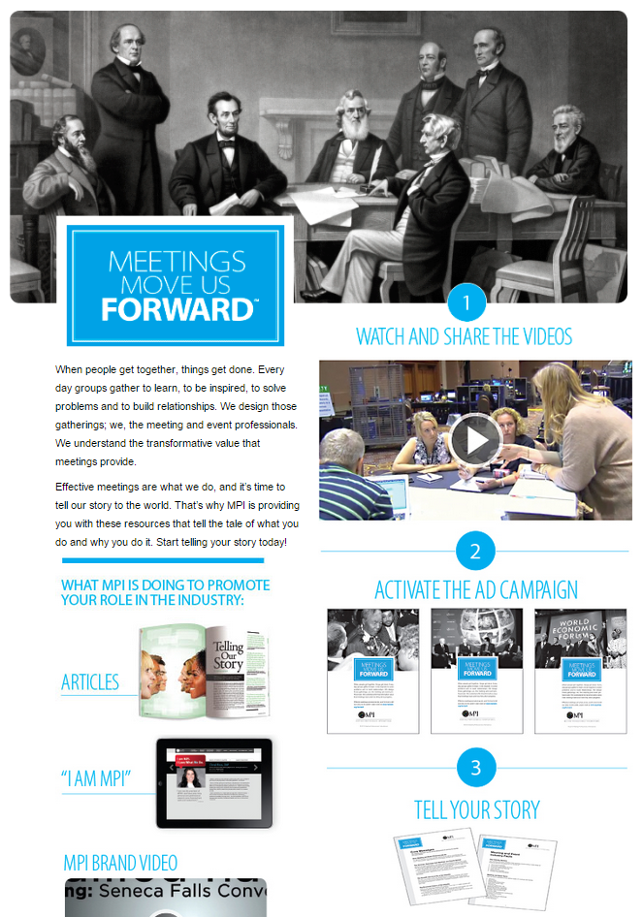
Meetings Move Us Forward
is a grassroots resource created by MPI to help teach members how to talk about the meeting and event industry in a consistent and meaningful way using a common language.
www.mpiweb.org/forward

Slide 26
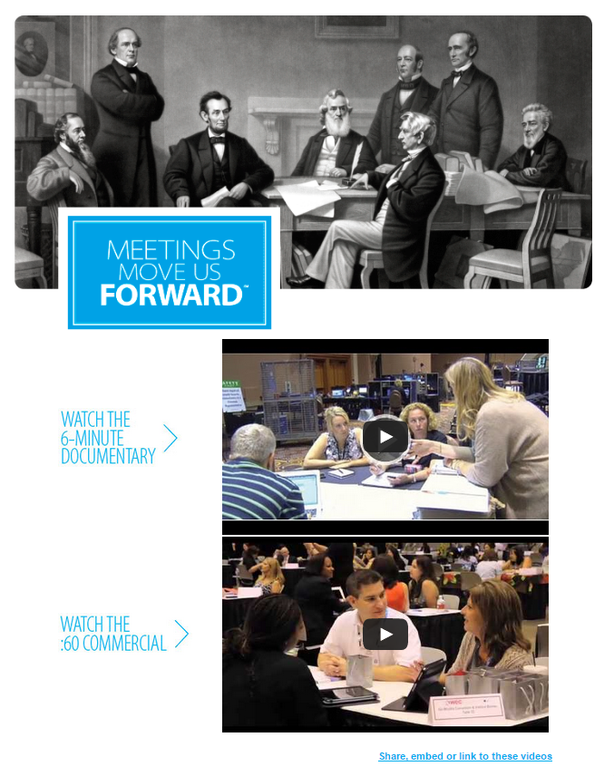
Industry Documentary
http://youtu.be/tyA91qCmhPg

Slide 27
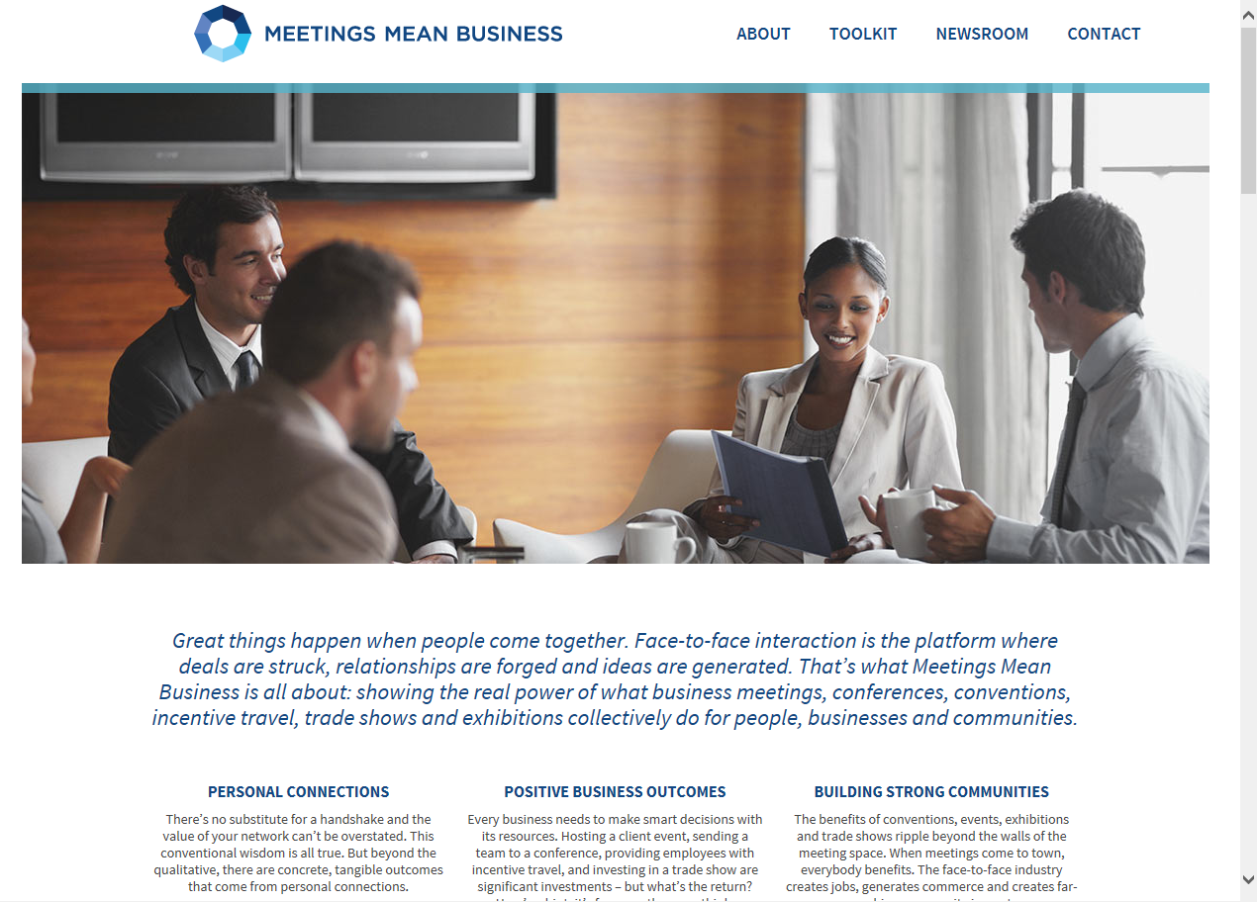

Meetings Mean Business Coalition

Slide 28
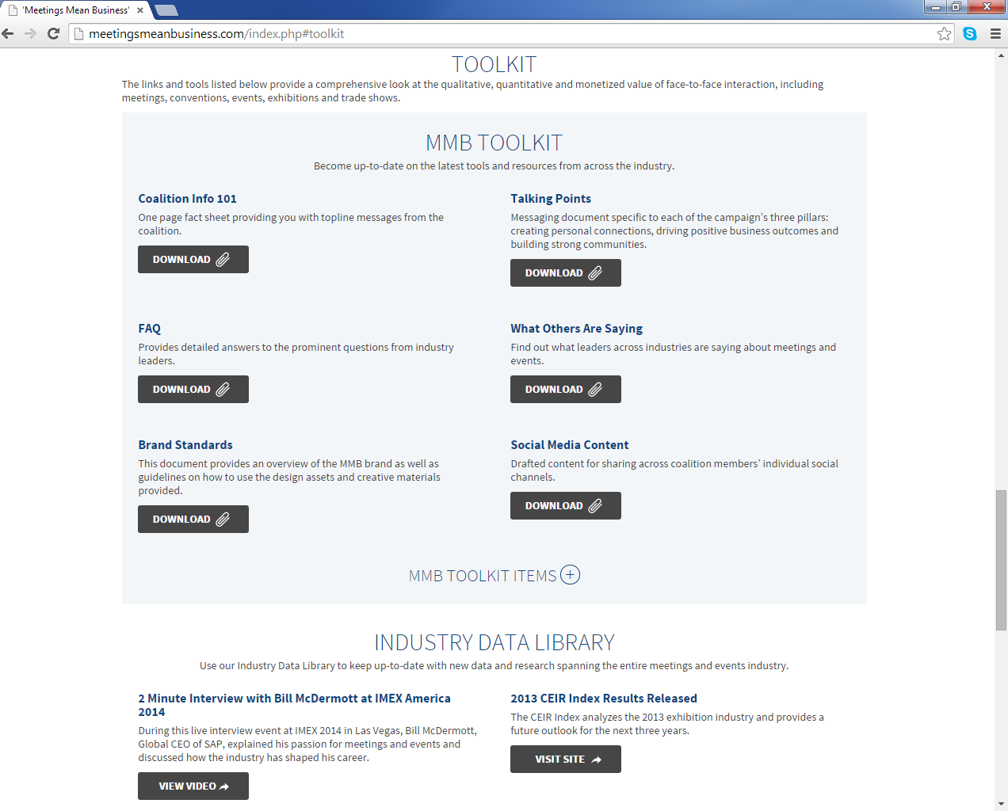
MMB Toolkit

Slide 29
I Am MPI

Slide 30
My MPI Experience
(Add Relevant Personal Bullet Points)
XXX
XXX
XXX

Slide 31
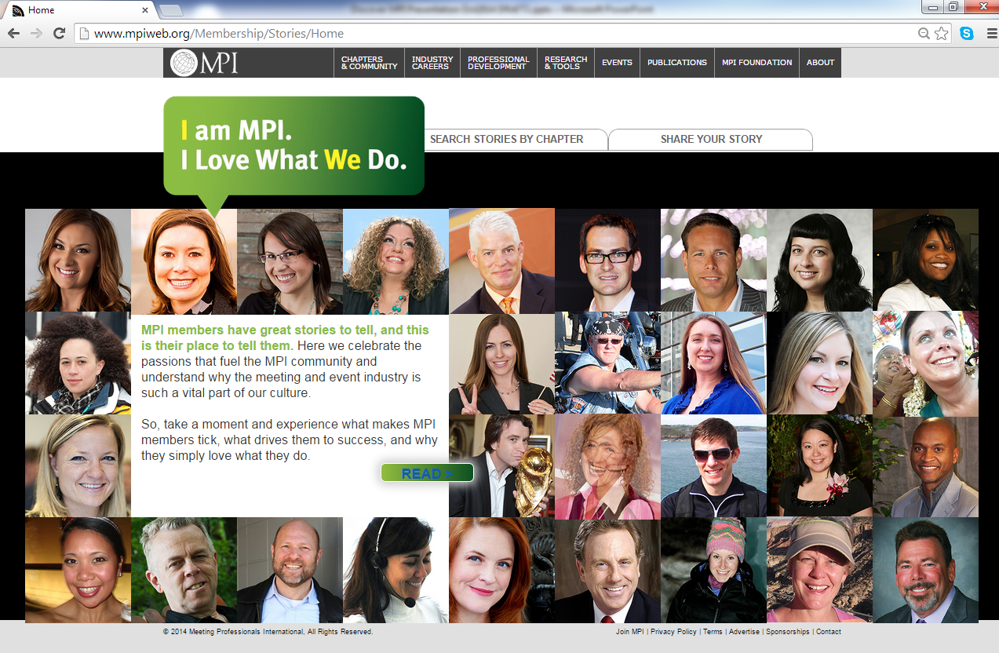
More MPI Stories

Slide 32
State of MPI

Slide 33

Recent Updates
Held 2015 World Education Congress (WEC).
  Delivered 140 total education sessions plus the keynotes and most qualified for clock hours.
  More than 2,500 registered attendees – a 25 percent increase over WEC 2014.
  About 80 percent of the attendees were MPI members and that number was split 50/50 among planners and suppliers.

Slide 34
Recent Updates
More stats from WEC 2015…
  For the MPI Hosted Buyer Program, there were 264 planners and 186 suppliers totaling 450 participants overall, which is a 12.5 percent increase compared to last year.
  MPI Foundation raised more than $270,000, exceeding the $170,000 raised during WEC last year.
  MPI also raised another $200,000 at the President’s Dinner, which will be used to enhance the platforms and content of education delivered by MPI to the entire meeting and event community.

Slide 35

Recent Updates
Announced future locations of WEC.
  Atlantic City in 2016
  Las Vegas in 2017
  Indianapolis in 2018
  Toronto in 2019
Introduced the MPI Academy and new certificate programs.
  Sustainable Meeting Professional Certificate
  Meetings and Events at Sea
  Sustainable Practitioner Certificate

Slide 36

Recent Updates
Announced 2015 RISE Awards Recipients.
Launched the MPI Experiential Event Series.

Slide 37


Recent Updates
Presented the Certificate in Meeting Management (CMM) to 46 meeting and travel professionals in June 2015.
Awarded the Healthcare Meeting Compliance Certificate (HMCC) to 227 recipients during the first half of 2015.

Slide 38


Recent Updates
Redesigned MPI Career Center.
Presented education at IMEX in Frankfurt, the GBTA Annual Conference, and more.
Preparations underway for IMEX America 2015 and MPI’s 2015 European Meetings & Events Conference (EMEC).

Slide 39
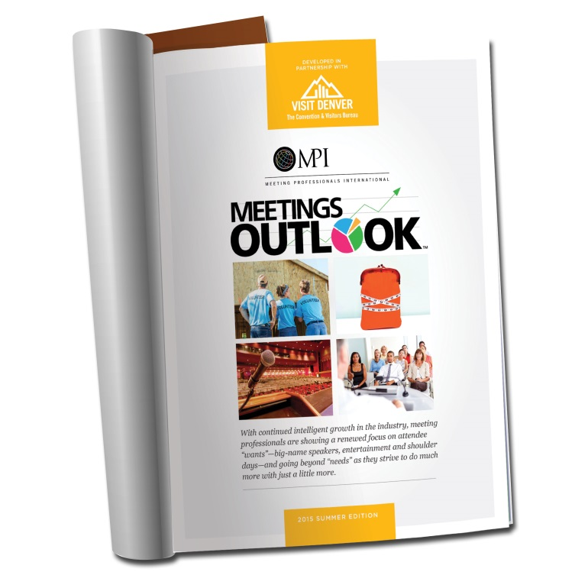
Meetings OutlookTM
Summer 2015 Edition
MPI’s quarterly report indicates continued intelligent growth in the meeting and event industry.
(Published August 2015)

Slide 40

Key Findings
Meeting professionals showing a renewed focus on attendee “wants” – big-name speakers, entertainment and shoulder days.
Only 17 percent of respondents are doing nothing to plan for the communication styles of the numerous generations of attendees; 40 percent comprehensively tailor planning for every event with this challenge in mind.

Slide 41
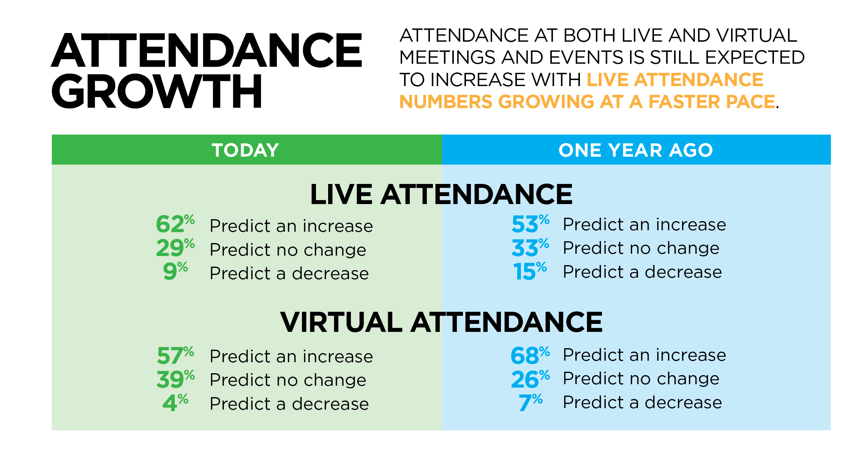
Key Findings

Slide 42
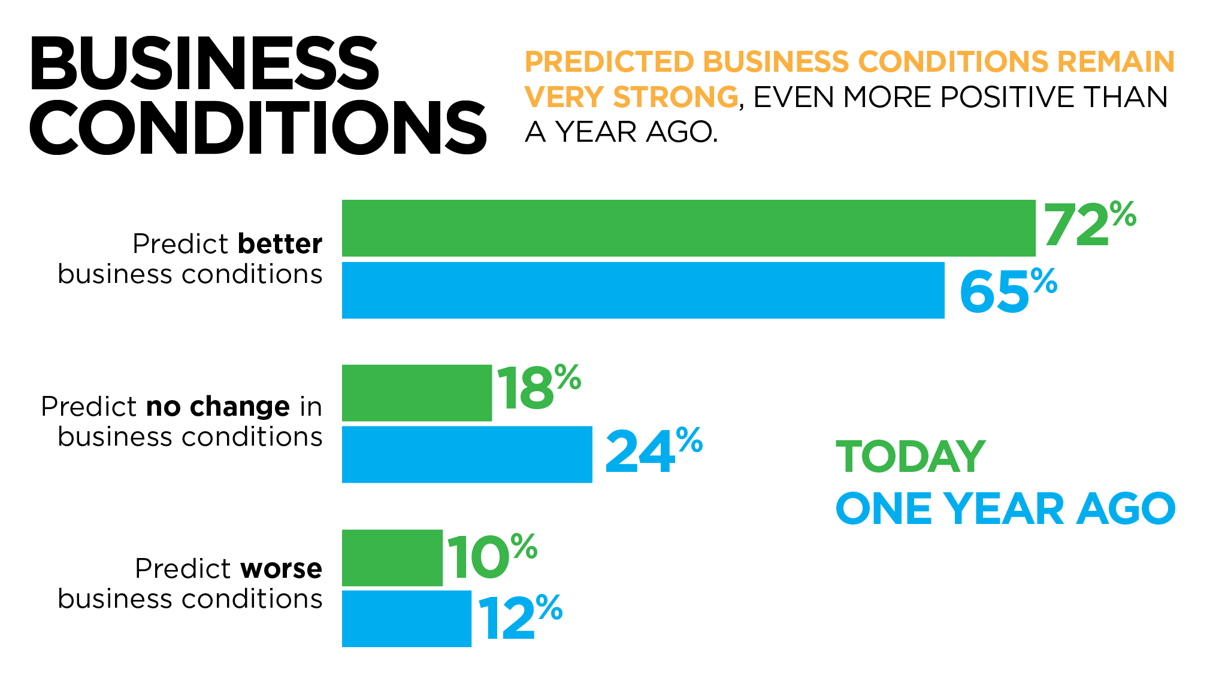
Key Findings

Slide 43
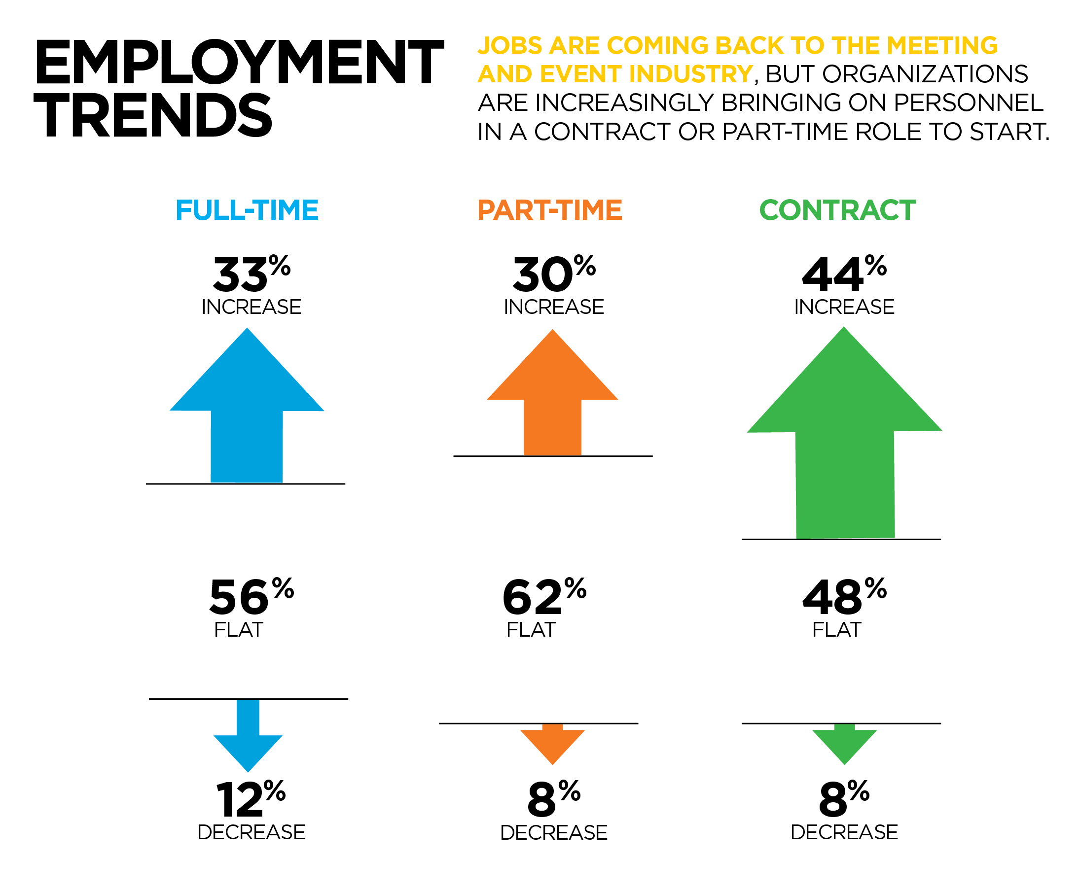
Key Findings

Slide 44
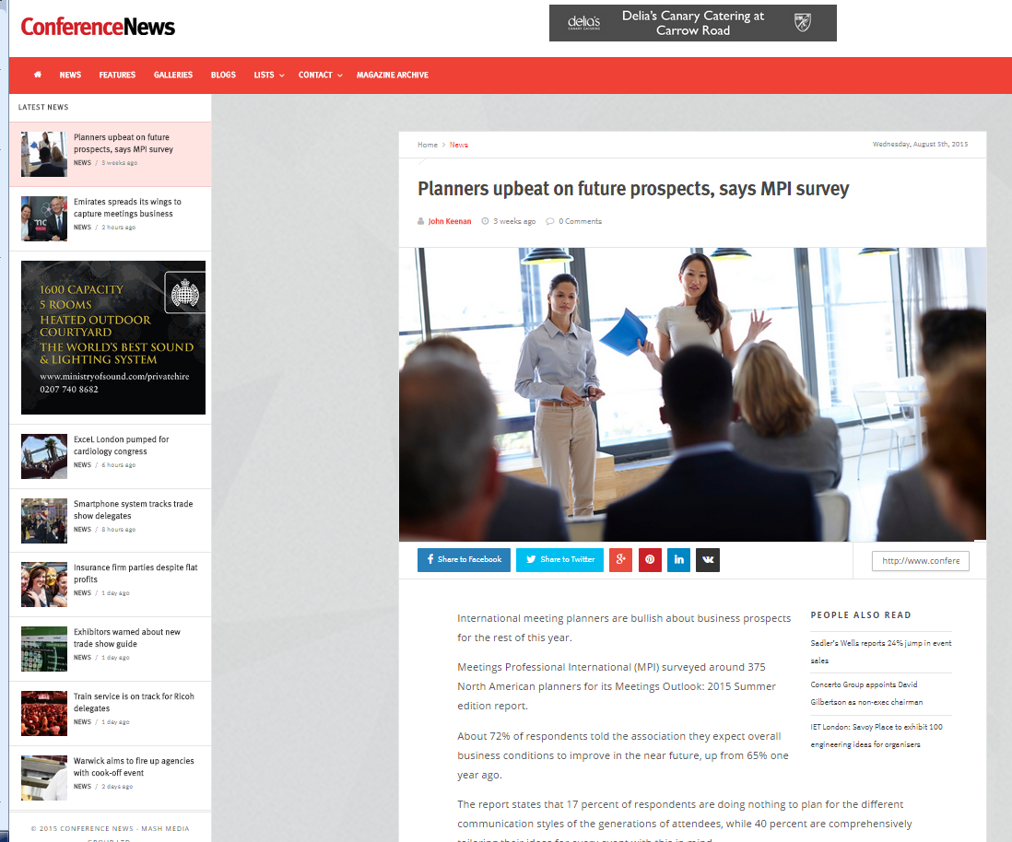
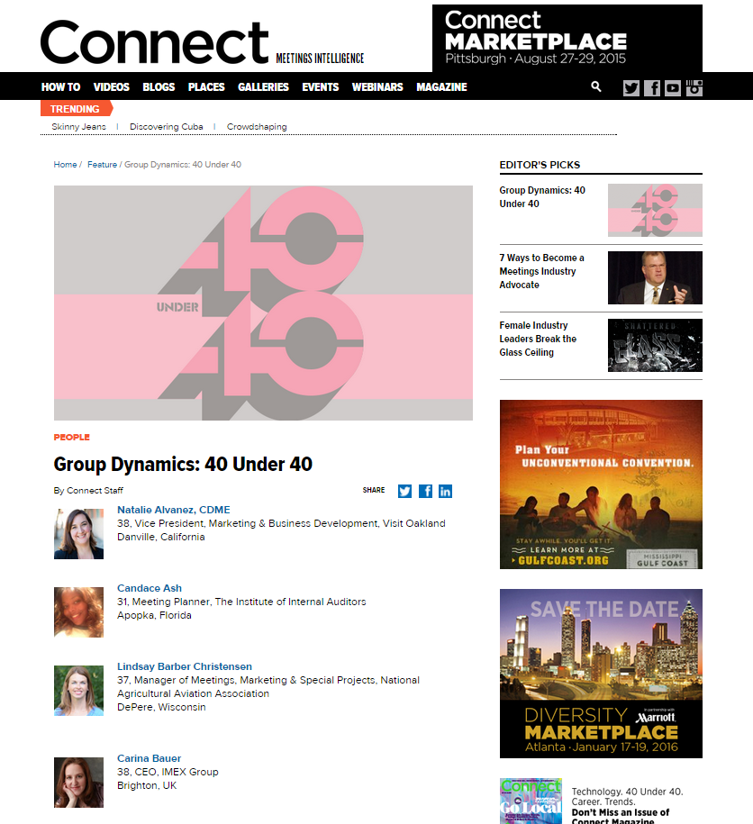
MPI In The News

Slide 45


MPI In The News

Slide 46


MPI In The News

Slide 47

Final Thoughts
Discover more at www.mpiweb.org.
Join MPI or renew your membership today!
Share your story and promote our industry.

Slide 48
Open Discussion

Slide 49
Thank You

