Slide 1
Communications Conversations
Presented by Lee-Anne Leckie
02/08/2014

Slide 2
MPI Toronto Chapter Value Proposition
Reasoning to Have a Value Proposition
The Greater Toronto Region has so many Industry Associations available to event planners and suppliers that we needed a line to show how important MPI was to the community and how we are the number #1 organization to be involved with
Did a poll amongst our members and the outcome was:

Slide 3
MPI Toronto Chapter Value Proposition
Engaged Suppliers receive 20% of their business from MPI Toronto Chapter
Networking
Member relationships
Education

Slide 4
MPI Toronto Chapter Value Proposition
Engaged Planners receive 20% cost savings on their events from MPI Toronto Chapter
Professional Development
Networking

Slide 5
MPI Toronto Chapter Value Proposition
Engaged Students receive 20% advantage in job opportunities from MPI Toronto Chapter
Networking
Committee members
Continuing Education

Slide 6
Communication Tool - Volunteers
BASECAMP
Basecamp is a web-based program that MPI Toronto Chapter uses for file and information sharing.
Resources and documents are housed here for your ease of access.
Committees post agendas, minutes, and information here
A) creates an historical record
B) document storage and retrieval
C) cuts down on email clutter and lost files
D) committees can use if they wish to facilitate communication between meetings – if you want to take advantage of this option, please let MPI Toronto Chapter know and we will give your committee members access
Dashboard
The Dashboard is a summary view of activity across all “projects” (Committees) that you have access to. Chairs have access to their own committee and the Committee Chair Resources

Slide 7
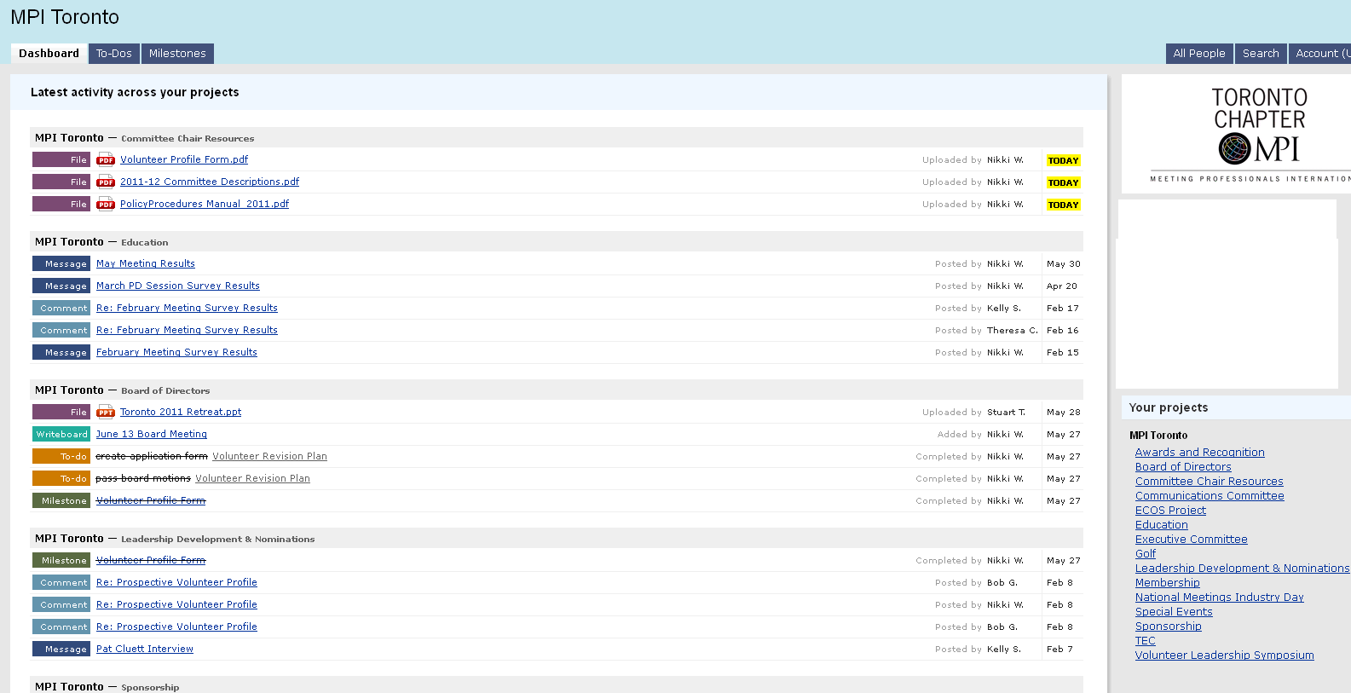
Communication Tool - Volunteers

Slide 8
Communication Tool - Volunteers
Project Overview
Click into a project folder and there are several tabs that you can access various options within the project
Project Messages
The messages tab is where you can post ‘messages’ about your committee.
As an example, the office will post the links to event evaluations under the ‘messages’ tab
You can add comments to other peoples messages as well
Project To-Do’s
You can create to-do lists related to your committee. You can have multiple to-do lists on the go.
Project Milestones
Milestones are the major achievements of your committee. You can create milestones to help you track the progress of your committee activity. (The critical path could be converted into milestones for example)

Slide 9
Communication Tool - Volunteers
Project Writeboards
Writeboard space is where you can brainstorm, share ideas, start agendas, etc.
Project Files
Files is where you upload your minutes, agendas, programs, etc.

Slide 10
Communication/Marketing Tool - Member
MPI Toronto is introducing an exciting new event icon system to help our members more easily identify the purpose and intent of various MPI Toronto Events

Slide 11
MPI Toronto Chapter Event Icons
MPI Educates – leading edge educational and professional development opportunities
Professional Development
Toronto Education Conference
Certified Meeting Professional (CMP) Study Groups
CEU credits/clock hours

Slide 12
MPI Toronto Chapter Event Icons
MPI Excites - your business, your career, your moments to shine
Holiday Gala
National Meetings Industry Day (NMID)
Awards Gala

Slide 13
MPI Toronto Chapter Event Icons
MPI ENLIGHTENS – opening your eyes to the endless creativity and potential of your industry
Signature Series Events

Slide 14
MPI Toronto Chapter Event Icons
MPI ENGAGES – networking opportunities you will not find anywhere else
New Member Receptions
MPI Connect
Annual Golf Tournament
Mentor Program

Slide 15
MPI Toronto Chapter Event Icons
MPI ENRICHES – make a difference in your industry and your community
Focus Groups
ECOS Project

