Slide 1
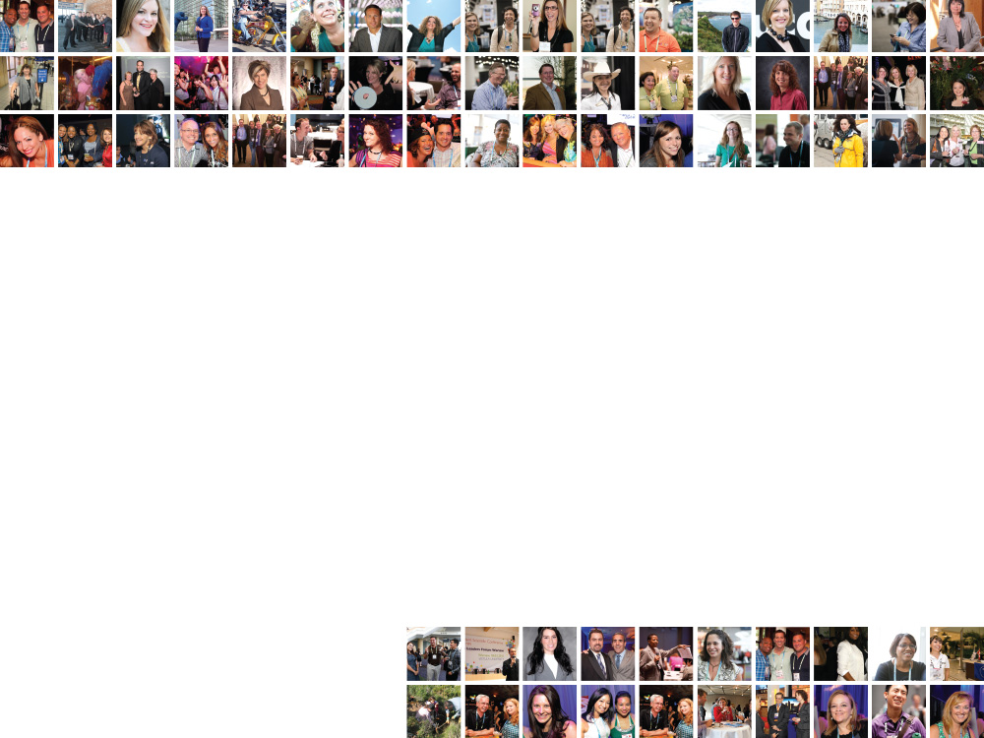
Negotiating Better Meeting Contracts Balancing Law & Practice
Presented By:
Name
Title
Organization

Slide 2
Learner Outcomes
Interpret contract clauses with a thorough understanding of the legal versus practical implications of each.
Integrate language reflecting current trends into contracts after anticipating the potential effects.
Negotiate stronger meeting contracts by customizing negotiations based on issues important to each party.
Twitter: @Jessie_States
Website: www.mpiweb.org

Slide 3
Contract Negotiation Myths
Myth
Black hats, white hats
Win-win outcome
Reality
Allocation of risks, meet business goals
Outcome will be compromise, strive for fairness
Notes:
Myths
Black hats, white hats – too often, we perceive “the other side” as the bad guy who is trying to pull something over on us. We enter into contracting with an adversarial mindset. Although there are good and bad people in every field, for the most part there is no “bad guy” and no “good guy” in meetings contract negotiations. There are just two people representing the interests of their business as best they can. In a fair contract, the risks are allocated between the parties in a reasonable way.
Win-win outcome – some people enter into contract negotiations with a goal to “win,” to get everything they want. By definition, “negotiation” isn’t a competition. It is an invitation to compromise. Unless you have a rock solid, highly-sought after product or piece of business, each side will likely have to give up some of what they want in order to get what they need. You can look at that as lose-lose, or you can look at it as fair negotiation. It’s kind of like a “glass half full” (optimist) or “half-empty” (pessimist) mindset.

Slide 4
Notes:
Know your business’ strengths and weaknesses.
It’s important not to skimp on the pre-negotiation preparation. Step back and take a good long look at your meeting (Planners), property (Facilities), or service (Other Suppliers). As objectively as you can, think about the relative strengths and weaknesses of what you have to offer. And it should go without saying, lead with the strengths but be honest about the weaknesses. Fair is fair.

Slide 5
Mind Your Business
Planners
Your meeting is a “piece of business”
Know strengths
Know weaknesses
Be honest but leverage strengths – like you would in any negotiation!
Notes:
There are two kinds of Planners: the ones who love negotiating contracts and the ones who hate negotiating contracts. This slide is mostly for the latter.
Some Planners take contract negotiations very personally. Don’t. Contract negotiations are just business. We often say our industry is a “relationship business.” That’s true in that we tend to do business with people we know and like. But it’s still business. And the more you can approach contract negotiations objectively, the better off you’ll be. Here are some tips:
Your meeting is a “piece of business.” Think like the hotel and try to objectively evaluate your meeting as a piece of business for that particular hotel, that particular time of year, that particular arrival-departure pattern, and so on. Try to see it the way the hotel sees it.
Every meeting has strengths. What are yours? Examples: Strong history (documented room night pick-up, revenue, ancillary spend, etc.), date- or pattern-flexible and willing to fit into slots the hotel needs to fill. QUESTION: Planners – what are the strengths of your meetings? Examples?
Just as every meeting has strengths, every meeting has weaknesses. What are yours? Examples: Most attendees book last-minute, your meeting uses a disproportionate amount of meeting space compared to the size of the room block, minimal food & beverage, etc. If your meeting has many weaknesses and not too many strengths, it may be what we call an “ugly baby.” (Admittedly, not a very PC term). Be aware of that and be realistic in your expectations. QUESTION: What are some other examples (anonymous, please) of weaknesses in a piece of business (Planners or Suppliers)?
Be honest but leverage strengths. Lead with your strengths. Be able to walk in and answer the question that hotels have on their mind (especially in a Seller’s market): “Is your meeting a piece of business I want? Or am I better off waiting for something better?” Some Planners walk in assuming sales people want every meeting they can get. But savvy sales people know that’s not true. Some “opportunities” are better left to pass on by.

Slide 6
Mind Your Business
Facilities
Yours is not the only property
Distinguish your property from others
Do your homework
Be nice
Notes:
Yours is not the only property. Savvy Planners keep their options open until after negotiations are done. Savvy Planners know that sometimes you have to walk away and go with Plan B…or in this case, Property B. So facilities – sell your property. You aren’t doing Planners a favor, you are winning their business.
Distinguish your property from others. What can your property offer than others can’t? Better location, larger or better-configured meeting space, more food outlets, free Wi-Fi? If you are in a market with a number of similar properties, plan to distinguish yourself through service, price, or another intangible. Just like Planners, you need to lead with your strengths in negotiations.
Do your homework. Research your client before they walk in the door. Do your research, read the RFP thoroughly. Know what is important to your client. If they aren’t price-conscious, don’t waste your time undercutting room rates. If they are price-conscious, be prepared to show them ways you can help them save money – a two-course meal instead of a three-course meal, bundling fees and surcharges into one reduced fee, and so on.
Be nice. Possibly the best business advice you can get – be nice. Planners book with sales people they like. Some planners follow sales people from property to property. Be likeable. Be “that guy” (or “that woman”) that everyone loves to work with. It will serve you (and your property) well in the end.

Slide 7
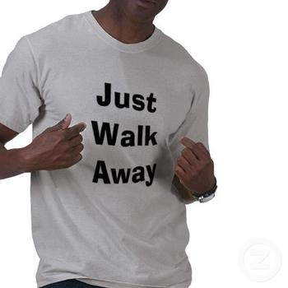
Know When to Walk Away
What’s your BATNA (Best Alternative to a Negotiated Agreement)?
When a proposal is better than your BATNA, accept it.
When a proposal is worse than your BATNA, reject it.
Fisher & Ury (1981). Getting to Yes.
Notes:
Know When to Walk Away
…and know when to run. (Kenny Rogers song)
There is a concept called BATNA (“Best Alternative to a Negotiated Agreement”) that was coined in 1981 in Fisher & Ury’s book on negotiations Getting to Yes. BATNA is basically the answer to the question: “When is no agreement better than the best agreement I can negotiate here?” In other words, know when to walk away. Know your “Plan B” (and ideally, Plan C, D, and E, too!).
An example: Suppose a Planner and a (pick a city) Hotel are negotiating. The Planner needs to go into the negotiation with their BATNA in mind. If the best agreement they can negotiate with the Hotel is not good enough, what’s the alternative? Another hotel that isn’t quite as perfect, but is sufficient? Another city? Different dates?
Likewise, Suppliers may (and do) decide that a particular piece of business isn’t worth all of the concessions asked for, the rock-bottom room rate demanded, or the amount of meeting space needed. Their BATNA, if they are lucky, is another client with a better piece of business over the same time frame. But their BATNA might be just waiting and hoping that another piece of business comes along. If that’s the case with your meeting, Planner, your meeting is probably “an ugly baby!”
If you are not willing to walk away, then you give away all of your negotiating leverage. If you are not willing to walk away, you could end up getting stuck with a bad deal or trying to get out of the contract. And getting out, as we all know, often means canceling and that can get expensive.

Slide 8
Notes:
The Most Important Clauses….are by and large those that carry the biggest financial risk. So that includes:
Performance clauses - attrition and cancellation
Clauses that shift the risk to someone else – force majeure and indemnification
There are many other clauses that are important, but if you put your negotiation power to work on these, you will minimize risk and maximize gain.

Slide 9
Cancellation
Notes:
If you are negotiating in good faith, you are not going into the deal thinking you will ever cancel. But there are hundreds of cancellations (by groups and by hotels and other suppliers) every year for various reasons.
QUESTION: Planners, how many of you have ever had to cancel a meeting or another type of contract with a supplier? Why?
Some examples (Planners):
Your organization merges with another organization and now you have two annual meeting contracts signed with two different hotels in two different cities.
The board, in all it’s wisdom, decides to cancel a particular meeting…and it is likely they don’t understand the financial ramifications of doing so.
Changes in corporate leadership, structure, or priorities make a particular meeting obsolete.
Although the next couple of slides use the cancellation scenario of a Group and a Hotel, the same cancellation principles apply to any type of contract—transportation, a/v, etc. Only the damages calculation is different.

Slide 10
Cancellation by Group
Creating a Cancellation Clause
“The parties agree that this is a liquidated damages clause and not a penalty.”
Damages based on a % of room and food and beverage revenue OR total revenue.
Sliding scale
Lost profits v. lost revenue – the legal case
Notes:
Liquidated damages v. actual damages
The first thing to determine in crafting a cancellation clause is whether it will be based on actual damages or liquidated damages.
Actual damages means just that—after the cancellation, the injured party (the non-breaching or non-cancelling party) adds up what their damages are and sends an invoice for that amount. In the case of a Group cancelling, this might include the Hotel’s damages for sleeping rooms, food and beverage, meeting space rental, and so on.
Liquidated damages means the parties agree that the amount included in the cancellation clause is a “reasonable approximation of the damages at the time of contracting.” This is why you see the language “The parties agree that this is a liquidated damages clause and not a penalty” in contracts. That just means – we agree this is a liquidated damages clause, so we can’t sue each other later saying it’s unfair. “Penalties” are not enforceable in contracts. So you can’t craft an enforceable cancellation clause that calls for paying $500,000 if the total revenue of the meeting would have been $10,000. That’s a penalty. “Damages” are enforceable.
Damages based on what?
The next issue is to decide what the cancellation damages will be based on. Rooms? Food and beverage? Both? Both plus meeting space rental? All plus ancillary revenue? In general, whatever is contracted for is fair game for use in calculation of cancellation damages. If it is not contracted for, then it’s debatable whether it should be included.
For example, suppose an association group books a meeting at a golf resort. No golf tournament is planned, but the hotel reasonably thinks some attendees will choose to play golf on their free afternoon (paying for it themselves). The hotel forecasts what revenue they will get from golf, so they may want to include an estimate in the cancellation damages calculation. On the other hand, the Group has not guaranteed nor contracted for any rounds of golf, so they may believe it should not be included in the calculation. There is no right or wrong answer – this is a point to negotiate. AND to be sure you know exactly how the cancellation damages figure is calculated and what it is based on.
Sliding scale = liquidated damages
Keep profit margins in mind. There is a legitimate legal reason to base cancellation (and other) damages on lost profits instead of 100% of lost revenue. The law requires the breaching party (or the party that exercises their option under the cancellation clause) to put the non-breaching party back into the position it would have been in had the contract been fully performed. If the contract was fully performed, then hotel rooms would have been occupied. An occupied hotel room incurs expenses—soaps, amenities, housekeeping services, linen service, etc. The profit margin on hotel rooms is about 75%, give or take. So the hotel earns $75 profit on a room that is sold for $100. So if the Group cancels, they pay the Hotel the $75 (75%) the Hotel would have been able to pocket—a reasonable estimation of damages, or what the Hotel is out because the Group canceled. If the Group pays $100 per room, the Hotel gets an extra $25 per room—they are actually better off because the Group canceled than they would have been if the Group had fully performed.
The profit margin on food and beverage is about 35%, give or take. So the sliding scale damages should top out at approximately 75% of room revenue and 35% of food and beverage revenue.
A contrary argument: Some hotels would say that although they may contract only for rooms and food & beverage, they do so knowing each person occupying the room will spend other money in the hotel—in the restaurant, the gift shop, the spa, etc. They have an estimate of this “ancillary spend.” An unoccupied room means no ancillary spend. So the hotel may include this anticipated revenue in the cancellation damages calculation.
Again, this is a point for negotiation. But if you don’t know about it—and the legal reason for it—you can’t negotiate it!

Slide 11
Cancellation by Group
Mitigating damages
Credit for:
Resold rooms
No liability for rooms not available for sale
No liability if occupancy = annual average occupancy rate for those dates
Rebooking the meeting (timeframe?)
Notes:
Another principle in the law is that the injured party has to “cover,” or try to minimize their damages. In the context of hotel contracts, this means the hotel has to use good faith efforts to resell rooms, space, food and beverage. This is known as “mitigating damages.”
The principle of mitigating damages technically only applies when “actual damages” (versus “liquidated damages”) are used. So, Planners, if a Hotel tells you that they are under no obligation to give you credit for resold rooms, they are not actually “double dipping” (taking your cancellation damages AND money from resold rooms, for example). They are technically correct.
In practice, however, we combine liquidated damages and mitigation (credit for resold rooms, for example) all the time. There is nothing wrong with it and it is completely enforceable if both parties agree to it in the contract.
It is worth negotiating whether (in the case of a cancellation by the Group), the Group’s damages should be reduced or eliminated if:
The Hotel is able to resell some or all of the cancelled rooms to another Group or to leisure guests.
The Hotel takes cancelled rooms off-market for renovation, repairs, or another purpose (the Hotel chooses not to mitigate).
The occupancy over the cancelled dates is the same or above the average occupancy rate over the same date for the last three years.
The Group is able to rebook a similar size meeting at the same property within the next 12 months (or within the calendar year).
Again, there is no right or wrong on any of this. These are just negotiation strategies.
In the scenario of a Group cancelling on another type of supplier, the mitigation strategy might be: If the supplier is able to book another Client that they couldn’t have booked had Group fully performed it’s contract, then the Group’s damages are offset by the amount of the new Client’s contract.

Slide 12
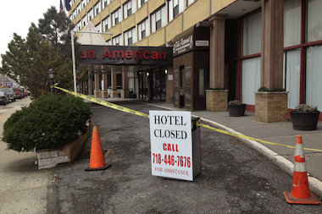
Cancellation by Hotel (or Supplier)
The same clause doesn’t work for both.
Actual damages
Mitigation
Notes:
QUESTION: How many of you Planners make sure there is a clause that addresses Cancellation of the contract by the Hotel? By other types of suppliers?
If there is no “Cancellation by Hotel (or other supplier)” clause in the contract, that doesn’t mean: (a) they can’t cancel OR (b) that they don’t owe any damages if they do. It just means that you have to argue about who owes what after the fact. Much better to have agreed to a clause up front.
Some people like to use a sliding scale and make it reciprocal. If Group cancels, they pay $30,000 and if Hotel cancels, they pay $30,000. This is probably not enforceable because the liquidated damages clause, if you recall, has to be a “reasonable approximation of damages.” The Hotel’s damages and the Group’s damages are not the same.
If using best practices, the “Cancellation by Hotel” clause should be an actual damages clause. That is, it should list the actual damages the Group will incur if the Hotel cancels. This usually includes a laundry list of things associated with having to find a new hotel (and sometimes a new city) for the meeting that the Hotel has canceled.
QUESTION: Planners, what expenses would you incur in this situation?
Answer: Depending on the time of cancellation, some or all of the following:
Travel expenses for new site inspection
Printing costs for printing new conference materials, ads
Expense associated with contacting all registered attendees to tell them of the change
Difference between the costs (rooms, food and beverage, etc.) at the new hotel versus the old Hotel
Refunds for registrations if people cancel due to the change (e.g., in city)
Refunds or cost of rebooking, if applicable, for airfare (if new city)
What else?
How does a Group mitigate its damages? It tries to rebook and to minimize the damages—book in the same city if possible, book in a similarly priced hotel if possible, etc.

Slide 13
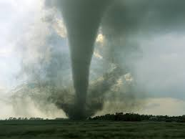
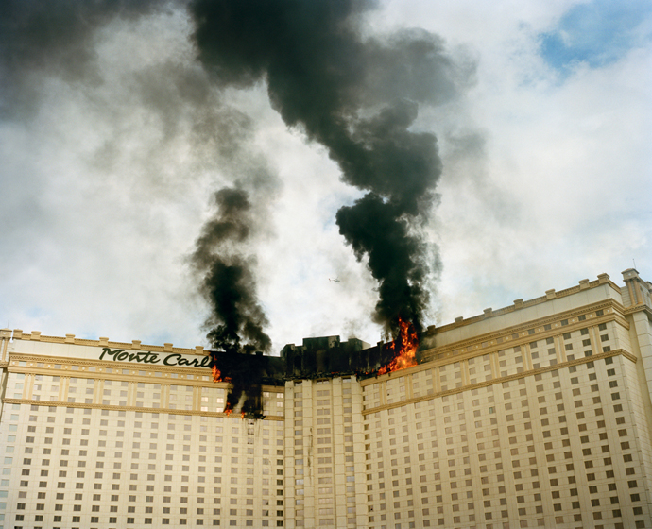
Force Majeure
Circumstances beyond the control of the parties
…that make it impossible, illegal, or impracticable to hold (or host) the meeting.
Notes:
Force majeure means “superior or irresistible force.” The contract self-destructs and the parties go forward as though a contract never existed. Note this does not mean no one is damaged – someone is out what they contracted for. This is why we have business insurance, which generally covers a loss if it truly falls under force majeure.
The two most important things to remember about Force Majeure clauses are:
It only pertains to circumstances that are beyond the control of the parties AND
It only pertains to circumstances that make it impossible, illegal, or impracticable (depending on how written) for the Group to have the meeting or for the Hotel to host the meeting (or for another type of Supplier to provide the goods or services contracted for).
Note that it is rarely impossible to hold or host a meeting – technically you could hold a meeting with two people or with one wing of the Hotel destroyed by a bomb, but you probably wouldn’t. It is rarely illegal to hold or host a meeting – unless the Hotel has been closed down by the Health Department, for example. Most force majeure cases come down to “impracticability” – it simply doesn’t make good business sense to do it.
Regarding (1) circumstances beyond the control of the parties – you may feel like it is beyond your control when the boss says, “Instead of holding our meeting in this city, let’s move it to that city.” But the contracting party is the organization (not you). And the boss is an agent of the organization and represents it. So that is making a choice to cancel, not force majeure. Ditto if the Hotel Director of Sales says, “The GM has decided to renovate the ballroom in October. Cancel all meetings using the ballroom in October.”
Regarding (2), circumstances that make it impossible, illegal, or impracticable for Group to hold (or Hotel to host) the meeting: if there is a tornado in Oklahoma, it doesn’t necessarily mean a Group can’t hold it’s meeting in Texas…unless it makes it impossible or impracticable for it to do so.
Examples:
If the tornado tore down the Group’s headquarters in Oklahoma – probably force majeure – it’s impracticable for the Group to hold the meeting;
If the tornado tore down the Texas hotel – definitely force majeure – it’s impossible for the Hotel to host the meeting;
If the meeting attendees are disaster response professionals in Oklahoma – probably force majeure – it’s impracticable for the Group to hold the meeting because the attendees have probably all been called in for disaster relief and can’t attend the meeting;
And so on.
QUESTION: Other examples, scenarios? Do you think they make it (a) impossible, (b) illegal, or (c) impracticable to honor the contract?
Some people add other occurrences that are not really “beyond their control” to the Force Majeure clause. They are better off in separate clauses. Examples:
Construction (“If the Hotel is under construction or major renovations that would disrupt the meeting…”)
Strikes [“If Hotel (or city) employees are striking…”]
What else?
“….then the Group can terminate the contract without liability.” Again – better in their own separate clauses even if very similar language.

Slide 14
Indemnification
“Indemnify, defend, and hold harmless”
+
“Negligence” (what flavor?)
+
“Including attorney’s fees”
Notes:
QUESTION: How many of you read every word of the indemnification clauses in your contracts?
You should. It is one of the most important clauses in any contract. The purpose of an indemnification clause is basically to shift responsibility for an accident or injury to the party that could have prevented it. In more legal terms, it is to make the party that had control over the “instrumentality of damage or injury” responsible for it.
Example (Hotel): If a chandelier falls in a Hotel, the Hotel has had more control over how that was hung (whether it was a reasonable weight to be hung from the ceiling, whether a licensed electrician was used, whether it was inspected after installation, etc.) than the Planner. So if the chandelier falls and injures an attendee, the indemnification clause says the Hotel pays for the damages, injuries, and expenses arising from the incident.
Example (Transportation Service): If there is a motorcoach accident and it is caused by a drunk bus driver, the transportation company has control over the hiring and training process (e.g., was a background check run on the driver-applicant, were references checked, etc.?). Suppose instead that the accident was caused by a blown tire on the bus. Again, the inquiry would be whether appropriate tires were used, whether they were checked and inflated to the optimal pressure, and so on. If negligence on the part of the transportation company is found, the indemnification clause says they pay for the damages, injuries, and expenses arising from the incident.
Three Things to Look for:
Indemnify, Hold Harmless, AND Defend… - If the language only says “indemnify and hold harmless,” you are missing part of the protection. Adding the word “defend” means that the responsible party (in the above examples, the Hotel or the Transportation Company) have to defend the lawsuit against you. They have to pay the attorneys, court costs, etc. Even if you “win” a lawsuit (or are excused from one), it is still expensive to pay an attorney to help you wade through the process.
Negligence – Look for the language in the indemnification clause that says each party is responsible for their own “negligence.” It may just say “negligence” or it may say “gross” or “sole” negligence. These small words can make a big difference. They are higher standards. Also note that the standard agreed to should be reciprocal. That is, if the Group is liable for it’s “negligence” then the Hotel should not be liable only for “gross negligence.”
Including attorney’s fees – Similar to the issue in the word “defend,” this means that the prevailing party should be reimbursed by the responsible party for it’s attorneys fees because, again, even “winning” a lawsuit can be expensive.

Slide 15
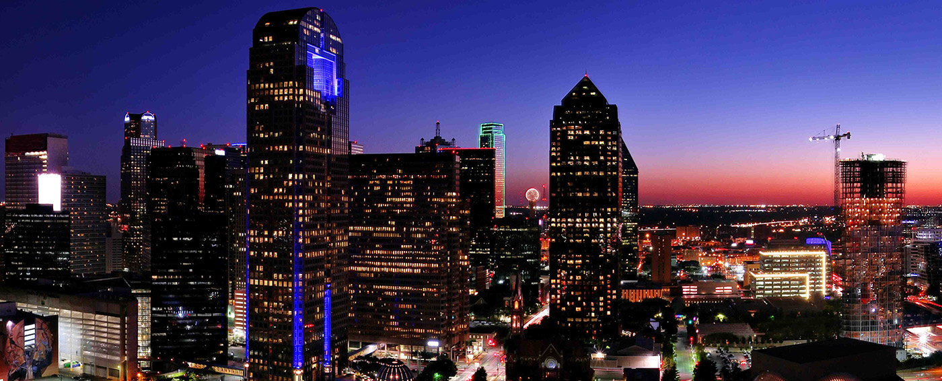
Attrition (and Related)
Issues similar to Cancellation clause
Related Clauses
Walk
Audit
Lowest rate/Internet rate
Notes:
Attrition clauses carry some of the same issues as cancellation clauses in terms of how damages are calculated—determining what revenue damages are based on (rooms, food and beverage), paying lost profits v. lost revenue, credit for resold rooms, applying damages to a rebooking. So we won’t go over that again here.
Instead, let’s talk about some unique issues with attrition clauses and some of the related clauses.
What is negotiable?
Everything is negotiable. When it comes to attrition, you want to negotiate the amount of allowable slippage, what revenue the damages are based on, if and when room block reductions (or expansions) can be made, cut-off date after which the Group rate won’t be available, and so on. But you also want to negotiate some other issues:
Walk clauses – Also known as “Dishonored Reservations,” imagine the scenario where some of the Group’s attendees are walked to a nearby hotel…and then the Group is charged for attrition. At the very least, the “walked” rooms should be credited to the Group’s block for purposes of pick-up. These guests intended to stay at the Hotel, but were turned away. The problem with walked guests is that sometimes they never come back. They just stay in the alternate hotel for the duration of the meeting. So consider whether the Group will get credit for all nights the walked guests stay away. Hotels – you should let Planners know if you will be in an oversold (or underdeparted) situation over their meeting dates. Planners – you should help the Hotel prioritize who to walk. If you can move your staff to keep some attendees at the contracted hotel, you might save yourself some headaches.
Audit clause – With Internet rates, government rates, corporate rates, Priceline, and such, it is altogether too easy these days for attendees to book outside the block at the official Hotel. Every Hotel contract should include a clause that says that the Hotel will compare the Group’s registration list against its in-house guest list so the Planner can “capture” a true picture of their pick-up. Whether the Hotel gives full or partial credit for attendees booked in the Hotel at rates lower than the Group’s negotiated rate is a point of negotiation.
Lowest Rate clause – Some Planners like to add a clause to the contract that specifies that the Hotel will not offer any rates lower than the negotiated Group rate over the Group’s meeting dates. This can have the unintended consequence of preventing the Hotel from being able to resell rooms that might be credited against attrition fees.
Example: Imagine there are four hotels in a four-block radius. Your meeting is at Hotel 1 at a $200 rate. You have a lowest rate clause with them, so they can’t sell rooms at less than $200/night. As the dates approach, the other three hotels lower their rates to $150 in an effort to fill the last few rooms. Your last-minute attendees don’t book Hotel 1 because it’s $50 more a night. You, Planner, have just lost your opportunity to get credit for a resold room.
It is better for all concerned to have a clause that says that the Group will get credit for any rooms booked outside the block regardless of rate paid. This is better for the Planner because they get the maximum number of attendees under one roof. It is better for the Hotel because the Hotel is better off with an occupied room than an unoccupied room.

Slide 16
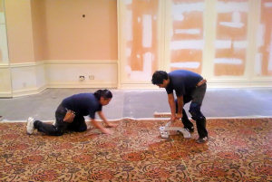
Construction & Remodeling
Notes:
Although there are many other clauses that are important, we will address just two more: Construction & Remodeling and Surcharges & Fees.
Construction & Remodeling
There is nothing worse (for either Planner or Supplier) than to have a signed contract and find out that renovations are being scheduled over the meeting dates. It’s not like the Sales staff make the decision on when renovations will occur. A good construction and remodeling clause specifies a remedy and follows an “if/then” format. Examples:
IF all the meeting space and services we need are not going to be available, THEN we can terminate the contract without liability and move the meeting. (Another option would be: THEN Hotel will find us space at a nearby hotel and provide transportation for attendees to/from).
IF the constructor or remodeling are loud or disruptive (in whose estimation?), THEN we get a discount on F&B or some kind of concessions. (Another option would be: THEN attrition is waived. This is a good option if attendees might choose to stay elsewhere or not come to the meeting at all.)
Some Planners try to negotiate that construction and remodeling will be suspended during the days/times they are in-house. This is an expensive proposition, but may be worth it to the Hotel if it’s a good enough piece of business.
The three other things that should be in this clause are: (1) The Hotel will inform the Group as soon as it knows of planned construction/remodeling, (2) Hotel will inform Group if the construction falls behind schedule, and (3) the Hotel will inform Group of what will be affected (meeting space, sleeping rooms, swimming pool, restaurant, etc.).

Slide 17
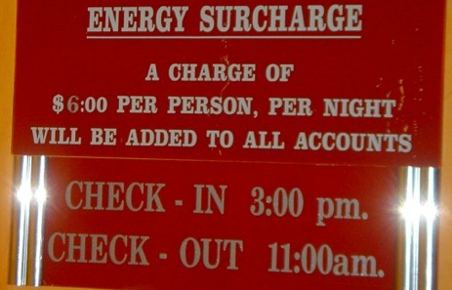
Surcharges & Fees
“Neither the Group nor its attendees will be responsible for surcharges and fees not enumerated in this contract or approved in writing by individual guests at check-in.”
Note: This won’t apply to taxes, which are levied by the government.
Notes:
Surcharges & Fees
The airlines started this practice of “unbundling” fees and surcharges in order to earn greater profits, and hotels have followed suit. Now a room with a $200/night rate may end up costing you upwards of $250/night by the time you add a newspaper delivery fee, a safe fee, a housekeeping surcharge, a porterage charge, and so on. This is bad enough for individual travelers, but can be truly devastating for meeting groups.
It will protect and prepare both parties (and, in turn, will allow the Planner to prepare the attendees) if the Hotel clearly enumerates all of the fees and surcharges that will be charged to either Group or its attendees. In fact, the parties might consider putting in the contract language that says “Neither Group nor its attendees will be responsible for any fees or surcharges not enumerated in the contract or approved in writing by individual guests upon check-in.”

Slide 18
Notes:
Now on to some trends and tips on what to look for and expect in the near future.

Slide 19
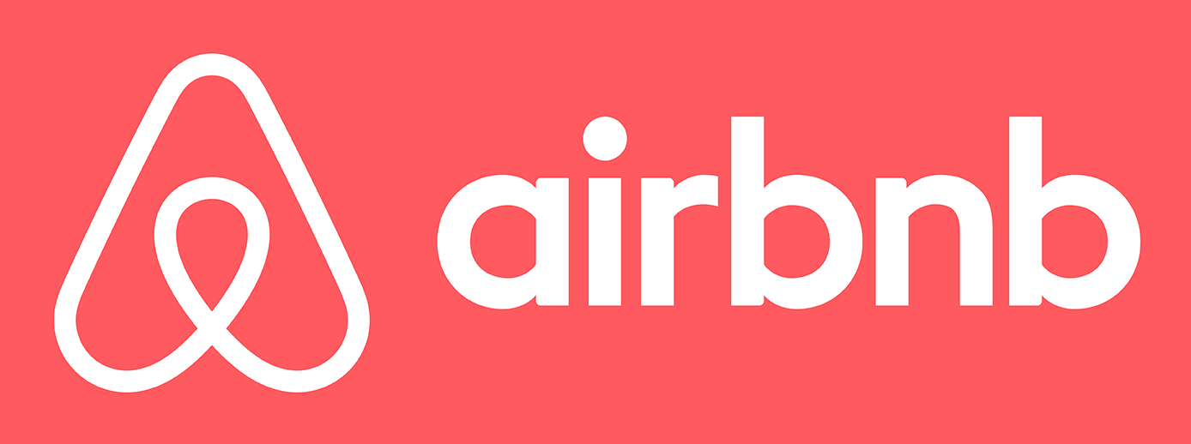
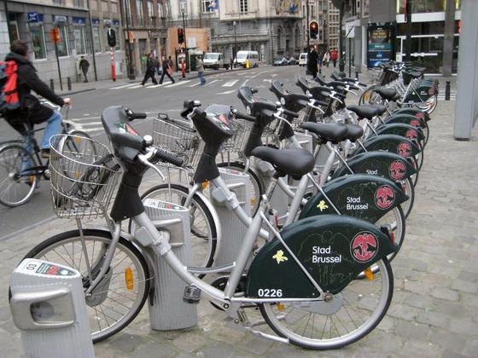
Expanding Options
Notes:
Meeting attendees have expanding options from indirect competitors to meeting suppliers. Some of the choices they may make can affect contract performance. For example, conference participants may choose to book outside the block with AirBNB or skip a catered meal function to take advantage of a meal experience with a group of locals through BookaLocal.
Convenient and inexpensive transportation options like bicycle rentals or ZipCar may make it easier for attendees to explore the meeting destination, before or after—or during—the scheduled meeting.
Both planners and suppliers need to be aware of these indirect competitors and anticipate how they might affect the meeting, in a negative or positive way. Rather than ignoring these options, the savvy planner may want to start thinking about how to incorporate them as a “value added” option for meetings.

Slide 20
Food & Beverage
Notes:
“Free” is a food & beverage trend that is affecting meetings—and by extension meeting contracts—now and in the future. GMO-free and other efforts to insure food is clean, wholesome, and healthy are being demanded by more meeting attendees. If this is an issue that an organization or its attendees considers particularly important, it should be discussed with caterers, restaurants, hotels, or other food suppliers. Standards and requirements should be spelled out in contracts. And as with any contract clause, there needs to be a “what if” clause: “What if the restaurant/hotel can’t provide the GMO-free (or other specialty food) it agreed to provide?” What is the remedy?
There is also a demand for more local food. This is not only a marketing opportunity for suppliers who provide food, an opportunity to showcase local farms and producers, but also a point for negotiations. Will local food cost more than bulk food provided by large food service company? Can custom menus be created based on local, seasonal offerings? What if weather conditions prevent a certain item from being available or raise it’s price? How will this be addressed in menus and pricing? These issues all need to be spelled out in the contract.
Finally, dietary restrictions are on the rise. Planners are getting more special requests than ever regarding food and beverages. Many are medically necessary, but some are purely preferences. In many cases, there is no way to know which is which so planners and suppliers have to be prepared for various special needs—some of which they will know in advance, some of which will be sprung on them at the last minute. The contract should address how the planner will notify the supplier of special needs and how last-minute requests will be dealt with. Planners should also specify in the contract that food will be labeled, not just “gluten-free” or “dairy-free” but with all of the ingredients spelled out on buffet signs or menu cards. There are too many allergies, intolerances, and medical issues to leave this to chance. There is a huge liability risk at stake.

Slide 21
Helping Economy
Notes:
We are in a helping economy. No longer satisfied with conspicuous consumption, many meetings are including a component of altruism or giving back. From community volunteer activities, to donating leftover food, to choosing business partners that are committed to similar causes (such as those who have joined The Code, a commitment to end human trafficking), we are making conscious choices to do good.
But again, many of these things require contract language including spelling out who will be responsible for which aspects of food donation, indemnification clauses to allocate the risk of liability, and insurance requirements for volunteer or other activities.

Slide 22
Americans with Disabilities Act
Notes:
The Americans with Disabilities Act is an often overlooked part of meeting contracts and in fact, some people (wrongly) say it doesn’t even need to be addressed in contracts because there is a law that outlines the responsibilities under the ADA. What many meeting professionals overlook is that the ADA as amended in 2008 is far more inclusive than it was previously. That is, more people are covered under the ADA as Amended than were under the original ADA of 1990. So meeting professionals who have been in the industry for a long time need to look again at the ADA and be prepared to address what accommodations will be made without charge, who will provide them, what external service providers can be used, and how services will be provided for disabilities ranging from vision and hearing impairment to medically necessary food restrictions to learning disabilities.

Slide 23
Meeting Fatigue
Notes:
Eventually, meeting attendees grow tired of the same old thing. There is a sense of “what have you done for me lately?” So planners have to innovate and change things up. Just be sure to spell out expectations in contracts so that each party is aware of the expectations, costs, and other details. Everyone loves a surprise. But not usually in their contracts.

