Slide 1
Discovering Your Chapter’s Brand Value
Presented by Chris Wezel
Orlando Chapter President
Notes:
A little about me.
Setting the session mindset:
Your chapter is a business so it needs to be treated like one.
When repositioning your brand value, be sure it’s tied to your business plan and your goals.
Be realistic when setting your timelines
Needs to maintain MPI Global brand standards
This effort is completely scalable
This is a process and will not happen overnight
Repositioning a brand is changing current perception
Have your boards “buy in”
The overall goal is to grow your business

Slide 2
Our Chapter’s Challenge
Perception of little or no value
Little member engagement
No member loyalty
Supplier weighted membership
Dismal attendance at events
Poor membership satisfaction (chapter ranked #56 in 2012)
No consistent brand vision

Slide 3
Strategy First
What are you great at? (not “good” – “great”)
EXACTLY who is your audience?
What motivates your audience?
What specifically is important to them?
How do you want your members to feel?
Notes:
5 critical questions you need to answer first. (Brainstorming session with your board)
This will also help get buy in from the board.
Be VERY specific when doing this exercise. Don’t be broad or your brand message and audience will become diluted.
NOT what you want to offer your members but how do you want them to FEEL?
WORKSHEET SECTION 1

Slide 4
If You’re Not Sure, Do The Research
Committee chair: Member Research & Development
Discover challenges
Uncover strengths & opportunities
Turn challenges into opportunities
Competitor analysis
Monthly metrics report
Annual national survey
Simply ASK!
Notes:
GOAMPI chair position. Michele, member research
The challenge our chapter was faced with
How we turned challenges into opportunities ( Supplier heavy = Biz to biz program)
Competitor organizations, hsmai, asae, nace, site, etc… (what do they do well?, what can you learn from them?)
Monthly metrics, annual survey, and event surveys ( How to analyze them. 15 minute discussion at board meetings)
Are you consistently asking your members what they like, don’t like, need, etc…) The biggest question is WHY ARE THEY MEMBERS? Why do they engage? Why do they cut MPI a check when it comes to renewing their membership?

Slide 5
Assessing & Utilizing Resources
Developing a repositioning committee
Partnership opportunities
Support tools from MPI Global
Support from chapter administrators
Technology (website template, e-communications, etc)
Maintenance team (can you realistically maintain)
Notes:
Committee Should consist of at least one board member from each department.
Also include:
Individual with Marketing experience
An individual engaged in Social media
A very creative individual
A non-member to gain perspective as to why they are not a member

Slide 6
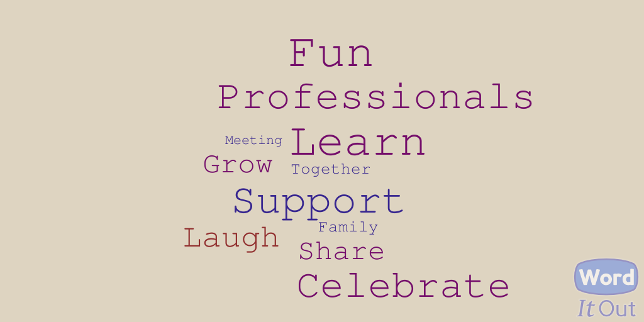
We Believe In Hugs Over Handshakes ☺
Notes:
What our chapter came up with. Our story:
What we learned sounded a lot like being part of a family. It had all the right elements.
Is it “marketable?” Can it be reflected in all member touch points?

Slide 7
Family Values
Share = business opportunities, connections
Help / Support = resources, referrals
Stay together = long lasting business relationships
Celebrate = laugh, fun, recognition
Nurture = learn, grow, professional development
Engagement = entertainment, hobbies, common interests
Notes:
We related key words to opportunities we can offer our members.
What do families do? How do they engage with one another? How do you feel being part of a family?
When a member steps into an event or engages in any way, how do you want to make them FEEL?

Slide 8

Critical Ingredients To A Value Proposition
Keep it relevant
Keep it focused
What is your exact solution?
What makes you different?

Slide 9
Critical Elements
Brand Promise - The pledge you make to your members about the experience they’ll have.
Brand Values – Every business decision should align with your values.
Brand Personality – Your brand must have unique & defining characteristics that compel your audience to get to know you and build a lasting relationship.

Slide 10
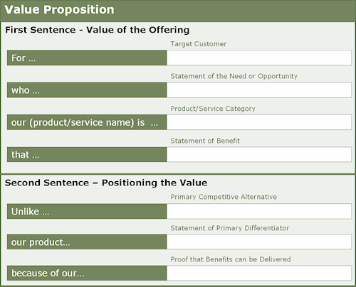
Developing Your Chapter’s Value Proposition / Positioning Statement
Notes:
Use value proposition generator:
4 specific components:
Business drivers (Determine the primary reasons members would engage in your chapter. This is what they REALLY care about)
Develop connections
Group business
Professional development
Movement: (They won’t engage unless what your offering is significantly better)
Increase
Improve
Remove
Eliminate
Accelerate
Strengthen
Grow
Maximize
Maximize
Metrics: (Adding metrics makes your value proposition stronger and more believable)
Time frame
Dollar amount
Percentages
Unique: (Separate yourselves from your competitors)

Slide 11
MPI Orlando Value Proposition

Slide 12

Your Communication Plan
Marketing messages
Marketing calendar
Digital platforms?
Budget

Slide 13
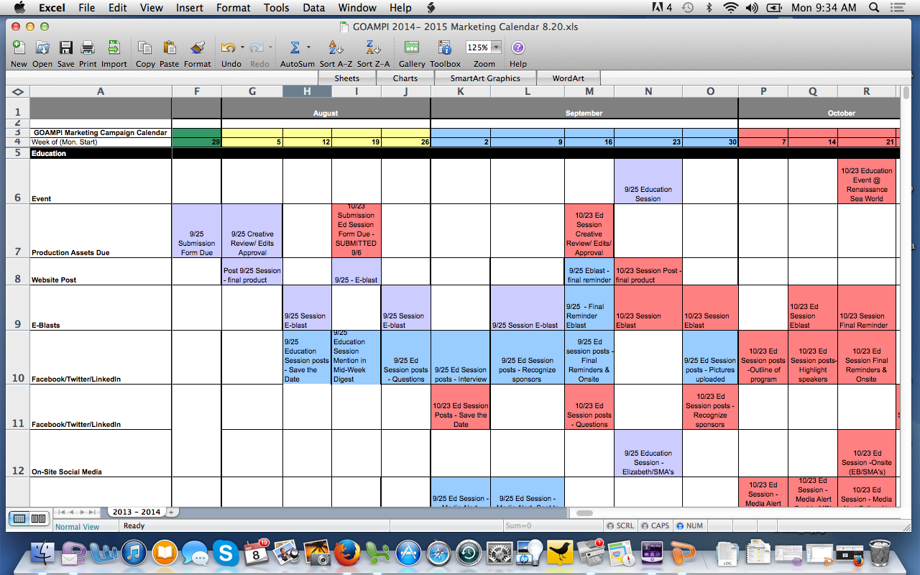
Let’s Roll!

Slide 14
Let’s ROLL!
Setting a realistic timeline
Website adjustments
Email marketing best practices
Social media ambassadors
Marketing liaisons
More is not always better
Measure, analyze, and adjust
Leave a positive impression at every touch point.
Notes:
Setting a realistic timeline
Website adjustments
Email marketing best practices
Best times to send emails
Subject lines
Call to action placement
Short and to the point
Personalize if possible
A/B testing
Social media ambassadors (Our team. Look for members that are active on social media)
Marketing liaisons
More is not always better (Too much and you will loose followers)
Measure, analyze, and adjust

Slide 15
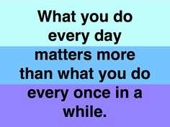
The Secret To Success Is The Consistency Of Purpose.
Carry the brand value through communications, events, membership and overall membership engagement.
Notes:
Your members and potential members experience your chapter through your brand and and through every touch point so you need to consistently carry the brand value through communications, events, and overall membership engagement. These experiences form a perception of your brand and become your chapters reputation.
Examples:
How can each department reflect your brand values / positioning?
Marketing: Recognition, Opportunities, member Monday.
Events: fun, interactive experiences.
Education: Grow, learn, professional and personal development.
Membership: Recognition, support, comfort, biz to biz.
Recognizing accomplishments for both business and personal (like a family)
Put yourselves in the drivers seat and experience your website, marketing collateral, events, and your monthly meetings. How do you feel? Impressed, motivated, disappointed?
Put yourself in your members or potential members shoes.

Slide 16
Along The Way…
Make it fun
Involve board & committee members
Be careful when asking for too many opinions
Recognize them for their efforts
Watch your timelines
Inspect what you expect
Think succession: develop SOPs along the way.
Notes:
Involving board & committee member. This is something they can be proud of and the experience itself ads value to their membership.
Too many Opinions can lead to major delays
Inspect everything throughout the process

Slide 17
Money Isn’t Everything.
But It’s Pretty Close To Oxygen!
Website visits up 25% to over 5000/month
Social media engagement up 400%
Event attendance up 20%
Overall membership satisfaction increased to 8.66. Our best in 10 years!
2014 global chapter ranking # 11 (2 years ago we were #56)
Notes:
Our chapter’s success. ANY business would be proud of these results.

